Slide 1
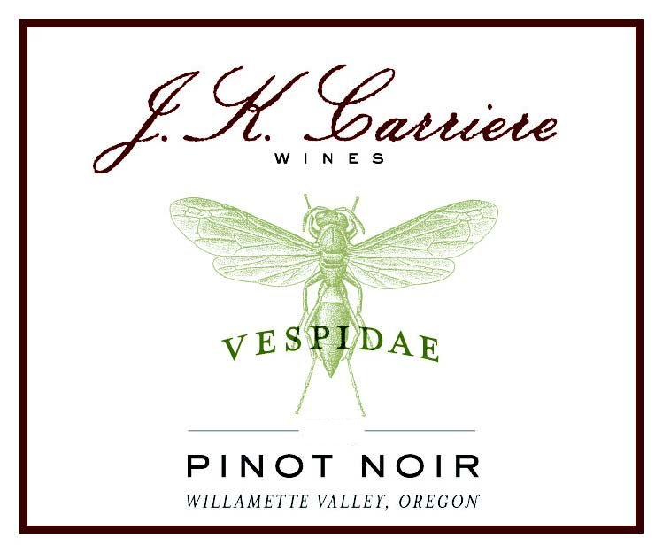
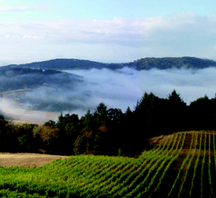
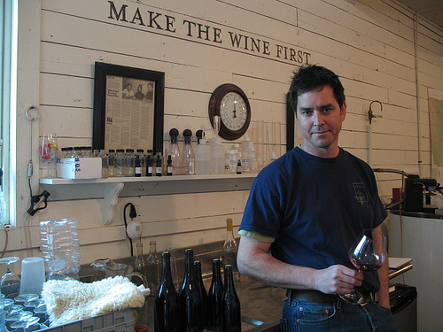
J.K. Carriere
Beware the wasp!

Slide 2
History of J.K. Carriere
Established in 1999 by Jim Prosser
The winery’s name is a combination of Jim’s grandfather’s names J.K. Prosser and Paul Carriere
Jim Prosser started off in finance and also worked in the Peace Corps
Bitten by the Pinot bug he worked with some great producers including Erath, Drouhin, Brick House and Chehalem in Oregon and Domaine Georges Roumier in Burgundy
The wines were made in a historic barn in Yamhill for the first 10 years
In 2007 he purchased 40 acres on Parrett Mountain in Chehalem Mountains AVA
First estate vineyards planted in 2009
The new winery was completed in 2009
Jim is deathly allergic to wasps…they keep trying to kill him

Slide 3
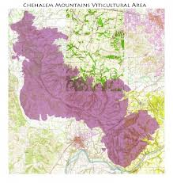
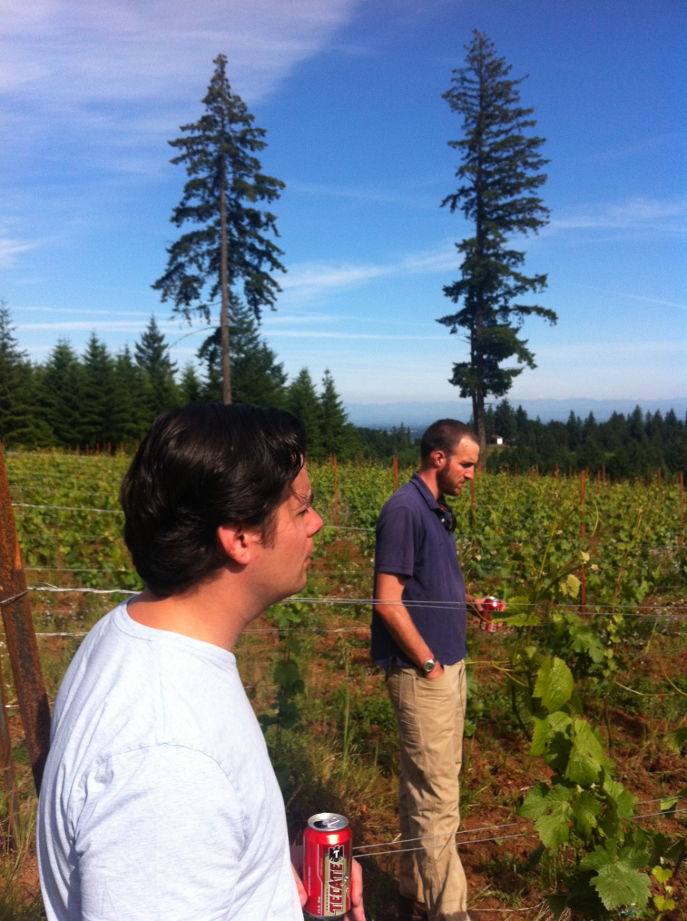
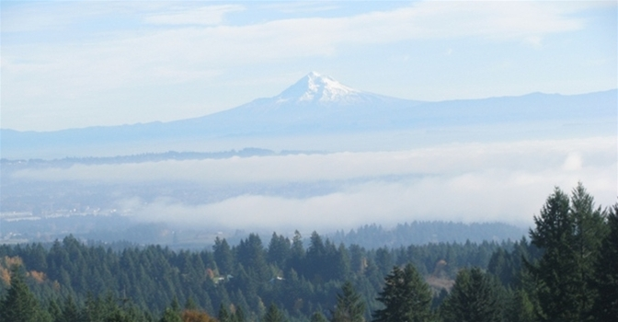

Slide 4
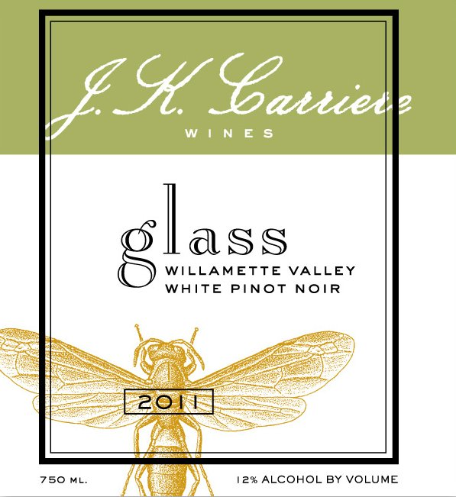
White Pinot Noir Glass 2012
From Temperance Hill’s 31-year-old Flat Block, Rocky Slope, and Triangle Block
Whole cluster pressed Pinot Noir
Barrel fermented to absolute dry using a long, slow, low-temperature
100% wild-yeast regimen to promote vineyard characters and preserve fleeting fruit esters.
Chardonnay lees are added mimicking Champagne methodologies from 100 years ago to strip color and broaden an earthy mid-palate
The wine is similar to a rosé Champagne without the bubbles.

Slide 5
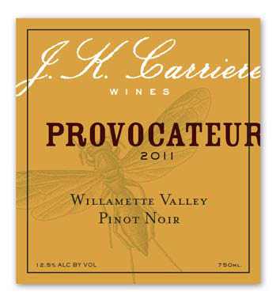
Pinot Noir Provacateur 2011
A blend of four vineyards,
  Black Walnut (8 years)
  Louis Vineyard (7 years)
  Anderson Family (21 years)
  Brooks Estate/Eola Hills (13 years).
Small-lot wild yeast fermentations in open-top stainless steel tanks
Limited pre-ferment maceration
100% barrel aged for 17 months in French oak, 19% new, 21% one year, 19% two year, 41% older
Racked and bottled, unfined

Slide 6
Pinot Noir Vespidae 2010
The flagship wine of J.K Carriere
Vineyards
  Shea Vineyard (13 years) contributed ripe dark fruit
  Temperance Hill (31 years) brought old-vine complexity
  Black Walnut (8 years) added sweet earth
  Anderson Family (20 years) supplied hi-tone and spice Six- to eight-barrel-lot, wild-yeast fermentations in stainless steel
100% barrel aged for 18 months (31% new, 26% one year, 43% three year or older)
Bottled unfined and unfiltered
791 cases produced

Slide 7
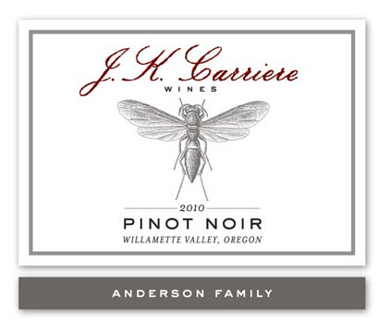
Pinot Noir Anderson Family 2010
The steep and rocky South Block of Anderson Family Vineyards is dry-farmed 20-year-old Dijon 115 clone Pinot noir
Some of the oldest Dijon clone Pinot noir in Oregon
Anderson Family Vineyard sets very small berries lending concentration without weight
On the more elegant end of the spectrum but still with great concentration
Small-lot wild yeast fermentations
100% barrel aged for 18 months in French oak barrels (one new, one once-filled, one twice-filled)
Bottled unfined and unfiltered
73 cases produced

Slide 8
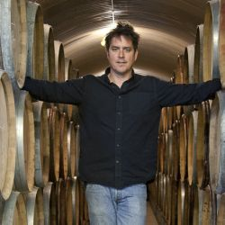
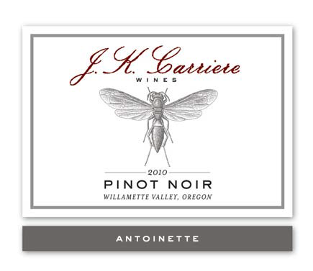
Pinot Noir Antoinette 2010
Antoinette is named for Jim’s grandmother (Carriere)
The wine is from the Temperance Hill Vineyard
31-year-old vines that ripen later due to cooler high-elevation
Old vine complexity with fresh acidity-the five best barrels became this wine
Small-lot wild yeast fermentations
100% barrel aged for 18 months in French oak barrels (one new, two once-filled, one three year, one four year)
Bottled, unfined and unfiltered
123 cases produced

Slide 9
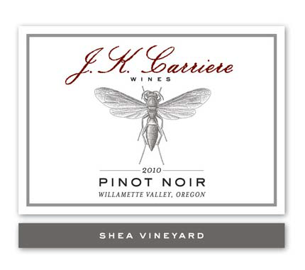
Pinot Noir Shea Vineyard 2010
A three-acre, mid-slope east block of 12-year-old Dijon clone 777 Pinot noir
The site is warm and early, delivering fruit of optimal ripeness
These are the five best barrels.
Small-lot wild yeast fermentations
100% barrel aged for 18 months in French oak barrels (two new, two once-filled, one twice-filled )
Bottled unfined and unfiltered
122 cases produced

