Slide 1
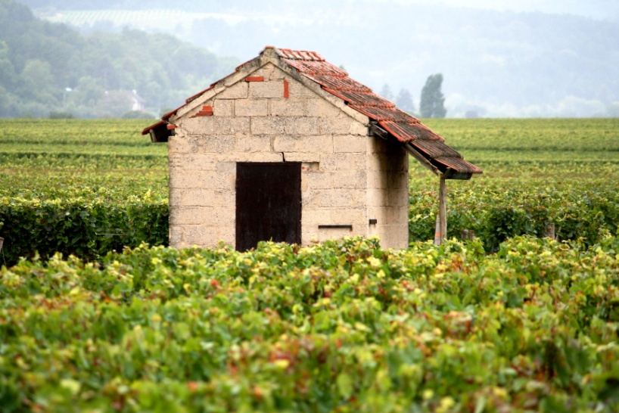
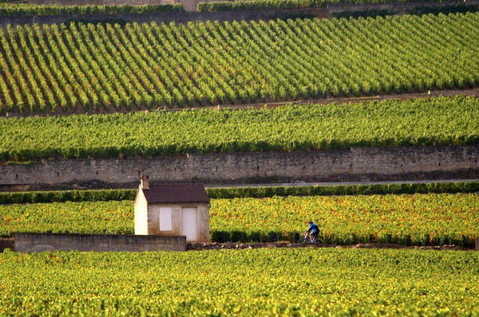
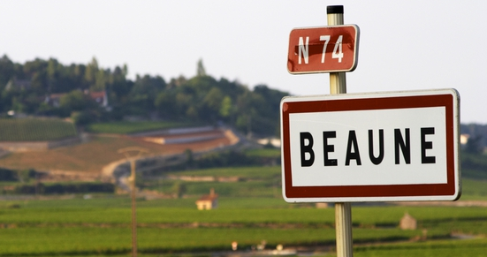
BURGUNDY’S CÔTE D’OR
POLANER SELECTIONS – TEAM SWEENEY+
SEPTEMBER 5, 2014

Slide 2
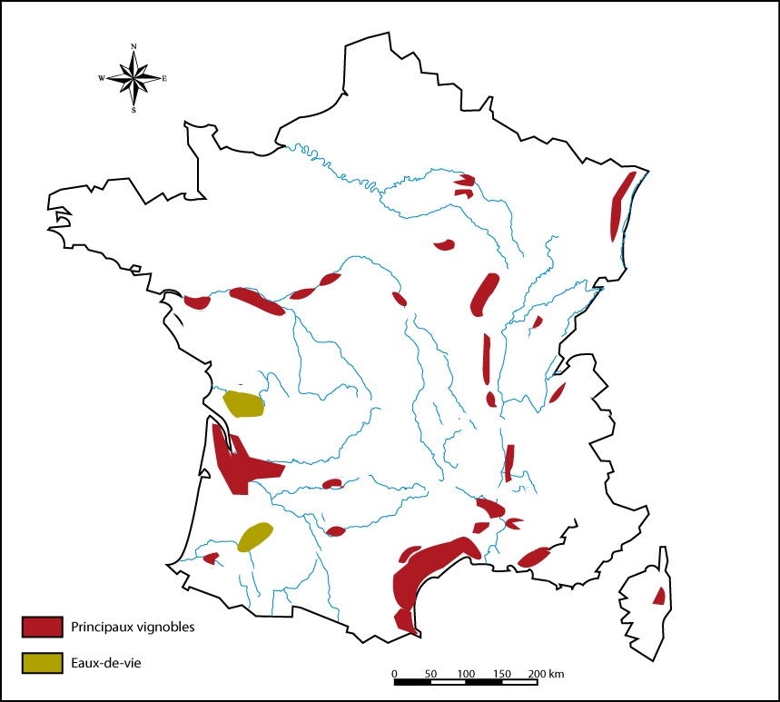
Geography Lesson: Where IS the Côte d’Or?
The gently sloping, east-facing strip of land between Dijon and Santenay is known as the Côte d’Or. A mere 35 miles or so in length, it is home to some of the most famous and evocative names in wine.

Slide 3
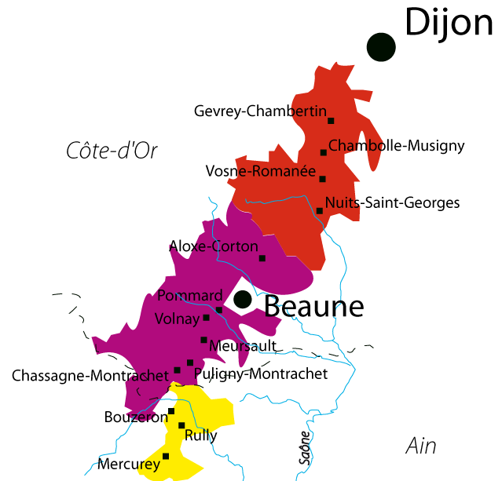
Why the Mystique?
(Why the Confusion?)
History: 10 centuries of detailed refinement; 25 centuries of wine production
Grape Varieties: monoculture with some historical oddities
Terroir & Organizational Hierarchy: detailed diversity, complex cru classifications (quality linked to location)
Modern status often bewildering: multiplicity of owners & approaches, minute parcels, small relative volumes, high valuation, under/over achievers

Slide 4
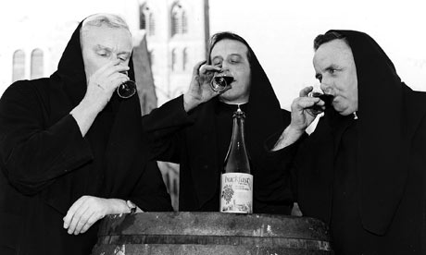
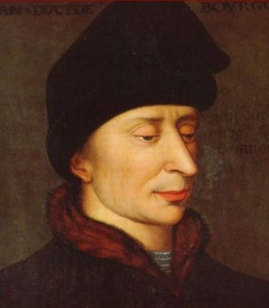
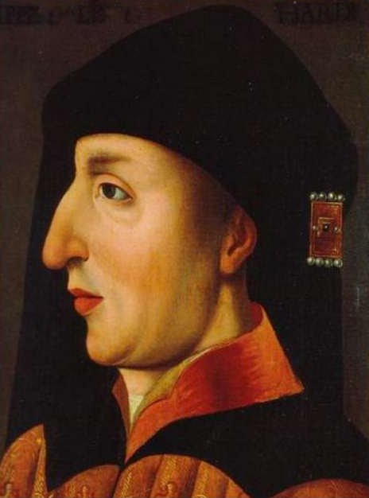
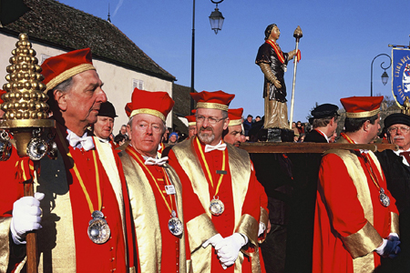
Long History,
Fine-tuned Traditions
Winemaking began with Romans in the 1st century AD.
Monastic traditions (5th Century) & Cistercian Order (11th Century on). Catholic monks planted vines in Middle Ages and grew grapes for the church and Dukes of Burgundy. Established disciplined vineyard practices, founded Clos de Vougeot, responsible for early fame of wines.
Classification systems beginning in 1416 with Charles VI.
French Revolution gave the wine back to the people. Early family domaines and traditions developed.
Modern developments (worldwide markets & competition)

Slide 5
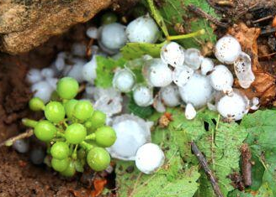
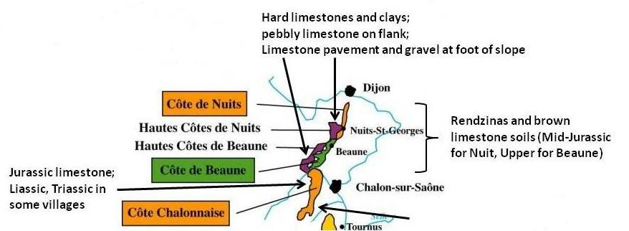
Climate & Geology
  Burgundy is situated at the edge of both continental and maritime influences, so the western winds, which bring rain, often lose moisture by the time they reach the hills of the Côte d’Or. As for the cold and arid north winds, they help to keep the vines clean and dry.
  Localized summer storms can bring hail – the greatest weather event threat to the vines and a tragic occurrence that has plagued many parts of Burgundy in recent years.
Burgundy has a complex geology. About 200 million years ago, the region was part of a vast, tropical sea , which left behind a strong presence of clay and limestone. Shells are often found in the soils.

Slide 6
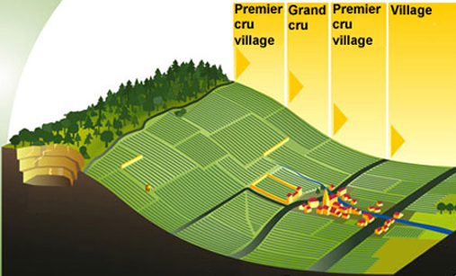
Cru Classifications
Reading the Slope

Slide 7
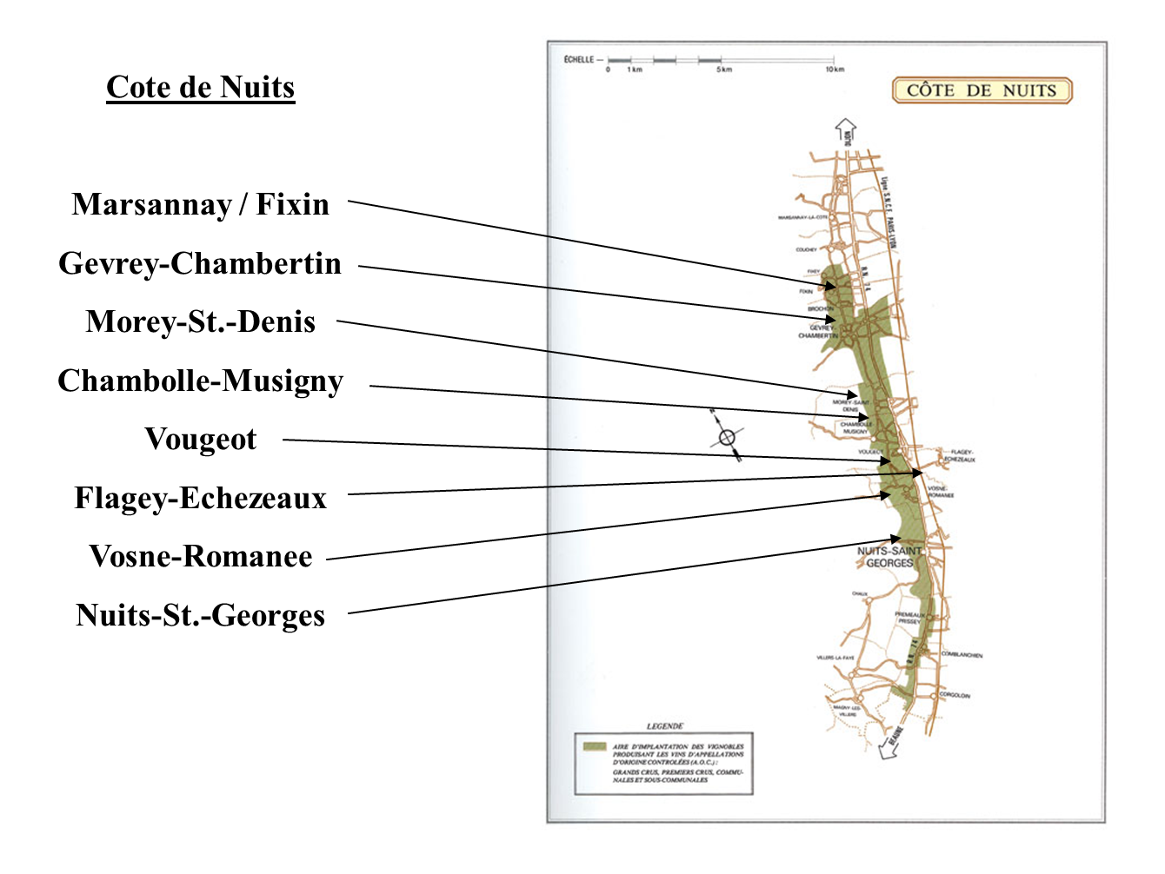

Slide 8
Côte de Nuits
This northern part of the Côte d’Or is better known for reds than whites, as it is home to the villages of Gevrey-Chambertin, Morey Saint Denis, Chambolle-Musigny, Vosne-Romanée and Nuits St Georges. Approximately 80% of production is Pinot Noir, 20% Chardonnay.
The Côte de Nuits is 13 miles total north to south and boasts 24 Grand Crus that form a patchwork on the eastern-facing slopes looking toward the Valley of the Saone River. The Grand Crus of the Côte de Nuits are some of the smallest appellations in France (due to structure of post French Revolution inheritance laws). The village of Gevrey-Chambertin has nine Grand Crus, more than any other village in the Côte d’Or.
Côte de Nuits Grand Crus tend to be Burgundy’s most powerful and long-lived Pinot Noirs, as well as its most famous.

Slide 9
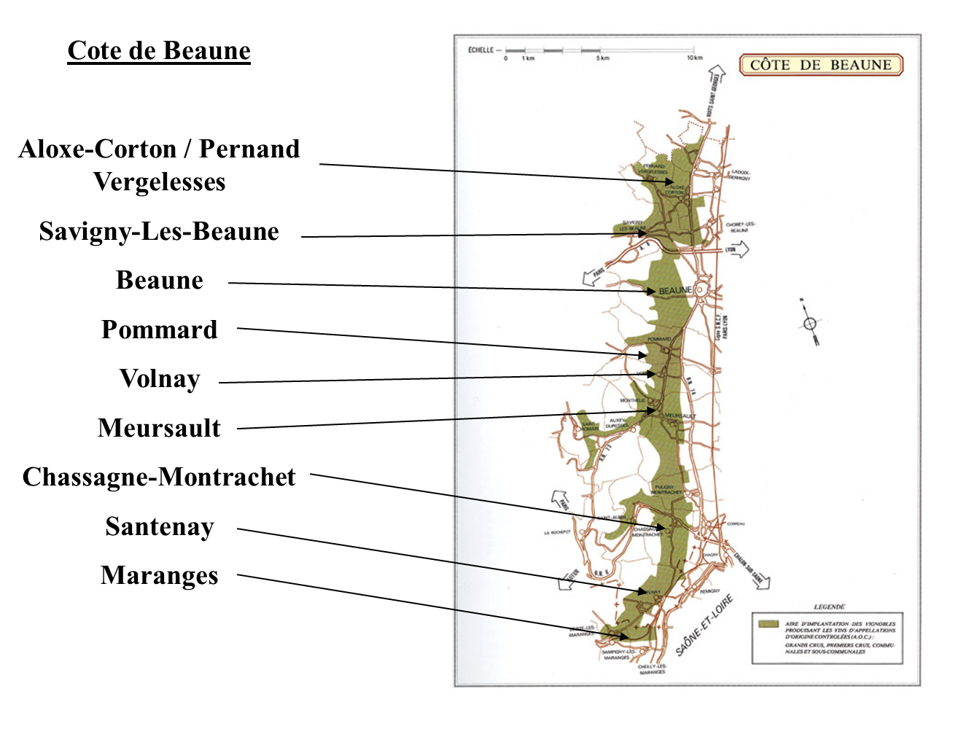

Slide 10
Côte de Beaune
This southern stretch is 18 miles long and produces twice as much wine as its northern neighbor. Here the valleys are open and rolling and the vineyards have more of a southeasterly exposure.
More famous for its whites. There are very good reds produced in the villages of Pommard, Volnay and Beaune, but it’s the Chardonnays from the villages of Pernand-Vergelesses (home of Corton-Charlemagne), Meursault, Puligny-Montrachet and Chassagne-Montrachet that are world famous.

Slide 11
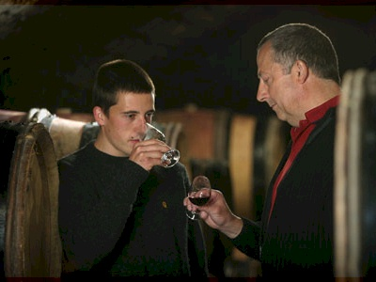
Pierre Duroché
Gevrey-Chambertin
Young Dynamo
New energy and dedication from incoming generation. Pierre is committed to maintaining family tradition while seeking even higher quality.
8.25 hectares in the village/appellation of Gevrey-Chambertin including top lieu-dits, a stunning 1er Cru Lavaut St Jacques, and an impressive array of parcels in the Grand Crus of Charmes, Latricières, Griottes and Clos de Bèze.
Delicate handling of fruit in the vineyard and in the cellar. Hand harvested, 100% desteemed, gentle pigeage, all in the name of finesse.
Style is understated power and elegance with fine-grained tannins and an earthy mineral core. Generous upon release, but requisite structure for ageing.

Slide 12
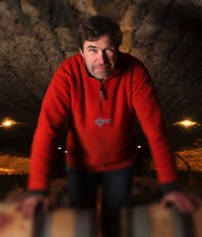
Jean-Louis Trapet
Gevrey-Chambertin
Poetic Terroir Translator
Fifth generation estate with a history in the village
of Gevrey dating back to 1870. Began as growers
(single largest owner of Chambertin in the 1920s)
and transitioned to estate bottling in 1960s.
Very gifted in vineyard holdings including Grand Crus of Latricières, Chapelle and Le Chambertin, but exceptional quality up and down the hierarchy.
Pioneer of organic, then biodynamic viticulture along with Leroy, Lafon, Lafarge and De Montille.
Style is more about aromatic and flavor complexity than it is about power. Terroir expression is the name of Jean-Louis’ game and he has solidified the estate’s reputation as a Gevrey superstar.

Slide 13
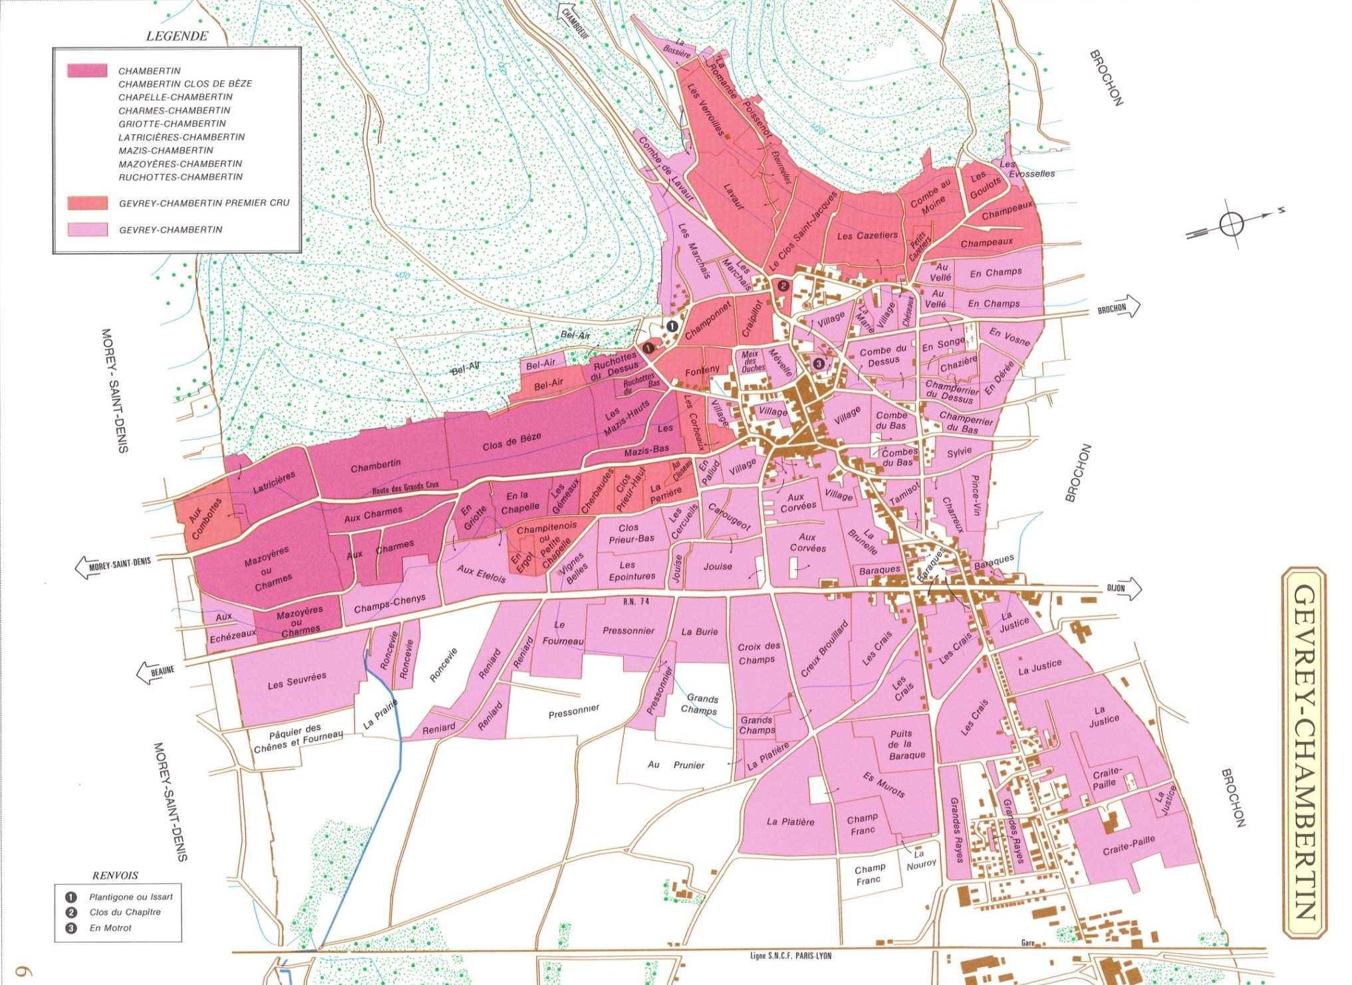

Slide 14
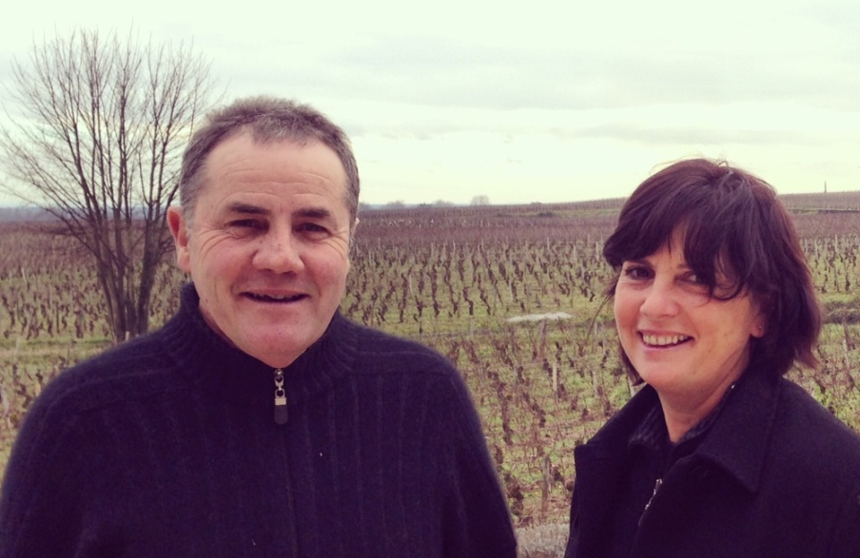
Anne & Hervé Sigaut
Chambolle-Musigny
Guided by a Burgundian Compass
Under the radar domaine crafting classic
and archetypal Chambolle from vines
Hervé inherited from his maternal
grandmother.
Although they collaborate on all aspects
of the farming and winemaking, Herve spends more time in the cellar and Anne is most at home in the vines.
Old vine parcels from the village top lieu-dit of Bussières and a bevy of 1er Crus that long ago tapped the mother rock of limestone that is the signature of Chambolle. Remained under-the-radar as they have no Grand Cru vineyards and have done little exporting.
All work done according to the moon cycle. Careful triage in the vineyard and in the cellar. Gentle handling and gravity-driven winemaking.
Style that caresses rather than clobbers. Energetic, ethereal elegance with fine floral
aromas and flavors.

Slide 15
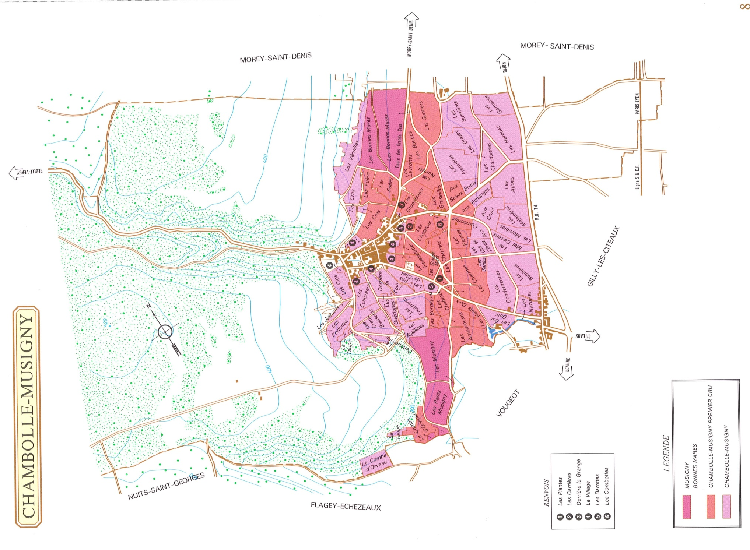

Slide 16
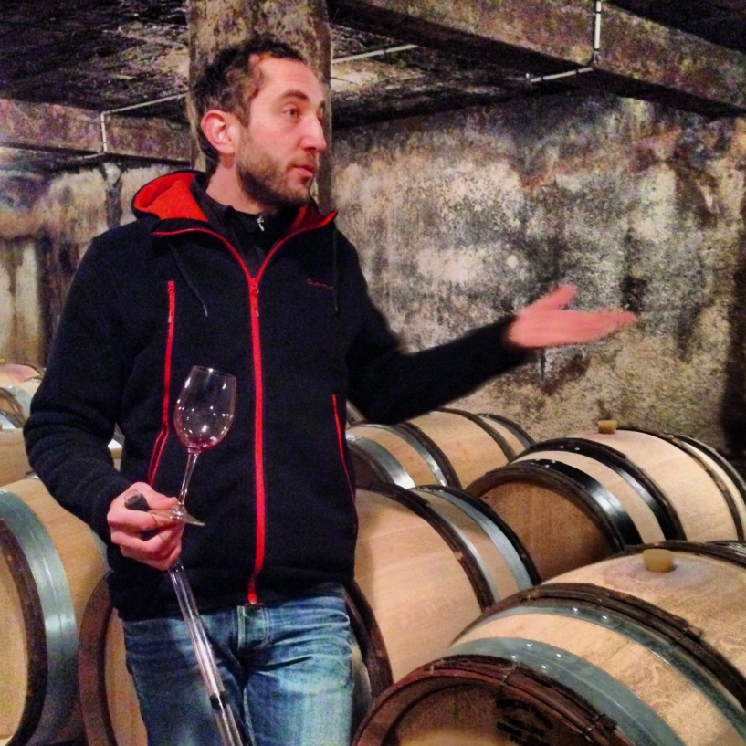
Antoine Lienhardt
Comblanchien
Lionheart
Humble overachievers Antoine Lienhardt
and Juliette Joblot believe that every vineyard
should be farmed as if it were a Grand Cru.
They began their project in 2011 with 4.2 hectares of Cotes de Nuits Villages holdings that belonged to Antoine’s grandfather.
Grand Cru-level care is evident. Special attention is made thru endless tasting to obtain
and harvest fruit that is physiologically ripe and maintains energy and vibrancy.
There is a famous vein of fine-grained marble called Pierre de Comblanchien which
extends from the village of Comblanchien to just south of Nuits-St-Georges. Antoine
feels this special terroir merits higher classication and his cuvées from Les Essards and
Les Plantes aux Bois are excellent arguments to this end.
These wines are all about energy and drive. After all, they have something to prove!

Slide 17
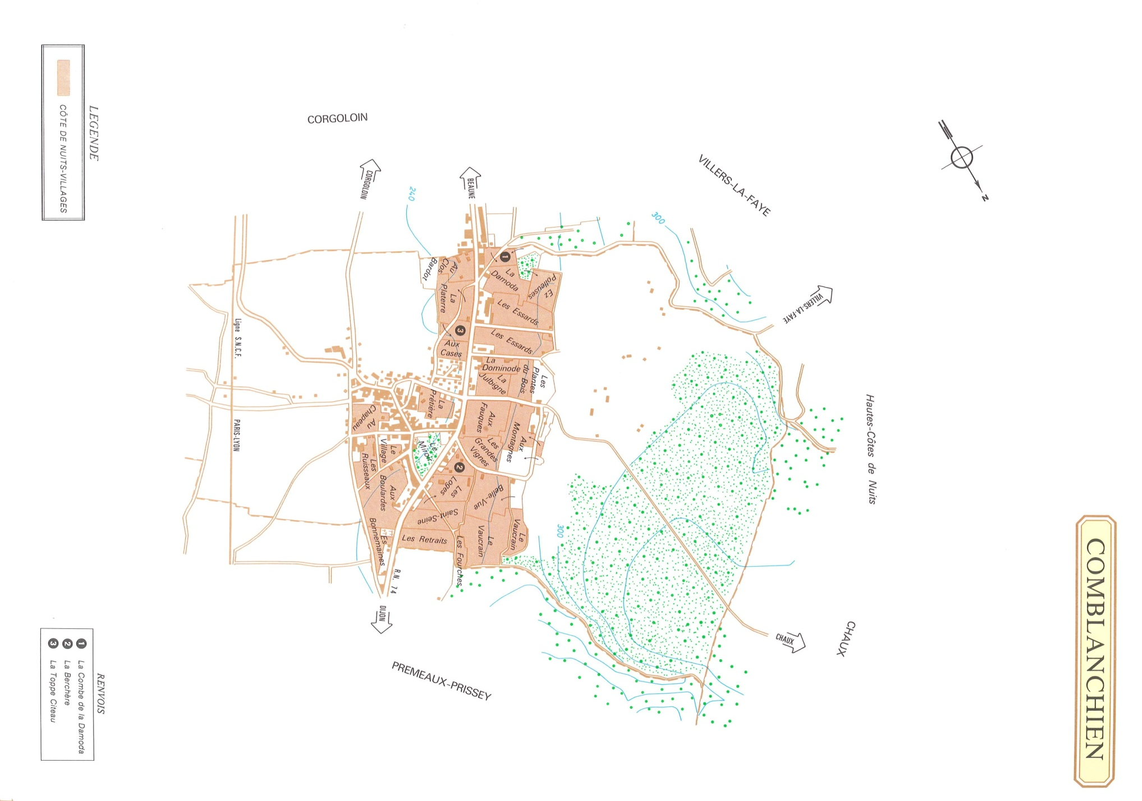

Slide 18
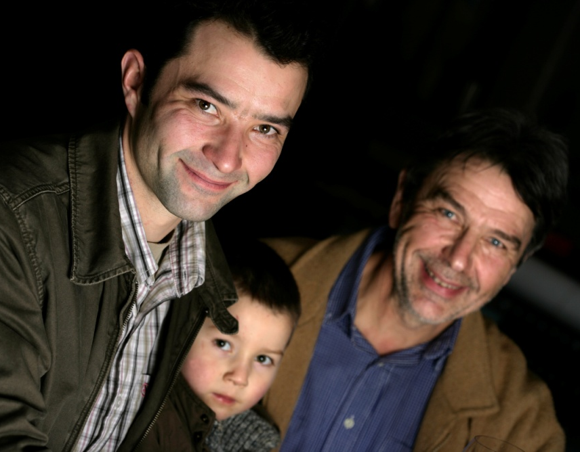
Camus-Bruchon
Savigny-les-Beaune
Quiet Killer of Savigny
Lucien Camus is a vigorous gentleman who took over from his father in 1971. it is evident that he has spent the lion’s share of his time in the vines.
Today his son Guillaume manages the Savigny estate, which is comprised of the old vine lieu-dits of Pimentiers and Grand Liards, top 1er Cru holdings such as Narbontons, Lavières, and Gravains, as well as vineyards in Pommard, Beaune and Chorey-les-Beaune.
No more than 25% new oak is used, allowing for a beautiful synthesis of pure fruit.
These are balanced, deep and sappy wines with the signature spice of Savigny and the elegance of a deft hand. The wines age gracefully and are among the greatest values in our Burgundy portfolio.

Slide 19
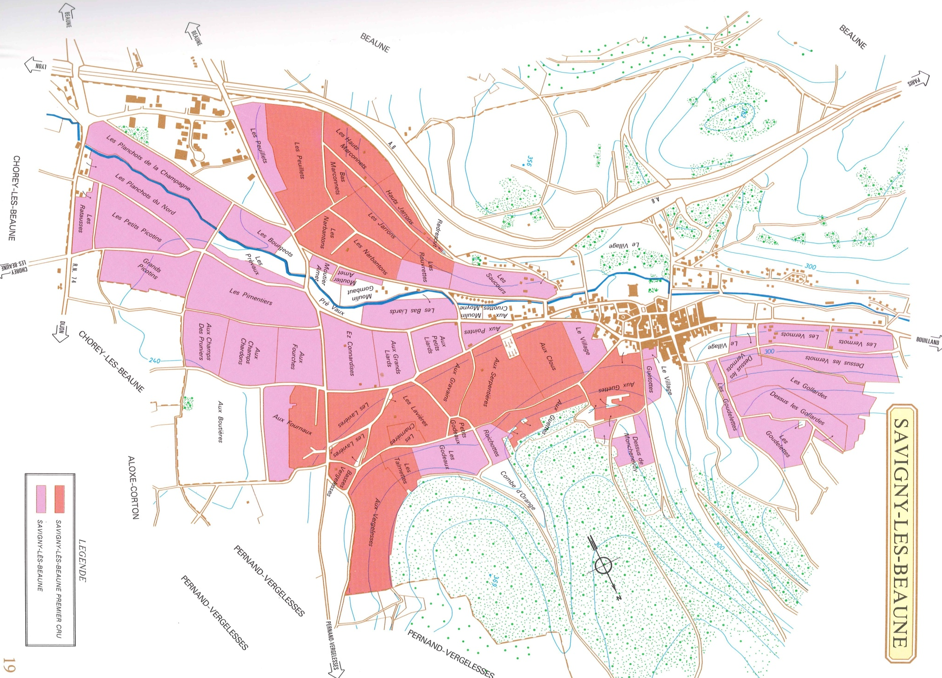

Slide 20
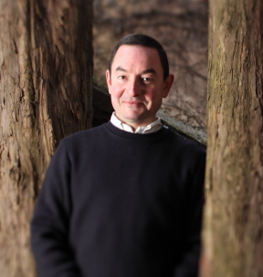
Michel Gaunoux
Pommard
Legacy Estate
Founded by Alexandre Gaunoux in 1885,
Domaine Michel Gaunoux has a long and
Enviable track record for producing brilliant,
age-worthy Pommard.
Today, fourth-generation Alexandre Gaunoux manages the estate, which is anchored
by the great 1er Cru vineyard of Grands Epenots in Pommard. The lineup is rounded out
with fine parcels in Pommard, Corton and Beaune.
Gaunoux Pinots are pure and soil-driven with the evident structure of Pommard
and Corton in their youth. Fortunately, the estate is committed to cellaring wines prior
to release to ensure they are strutting their stuff. Alexandre’s delicate approach has
resulted in more approachable wines right out of the gate…The New Gaunoux!

Slide 21
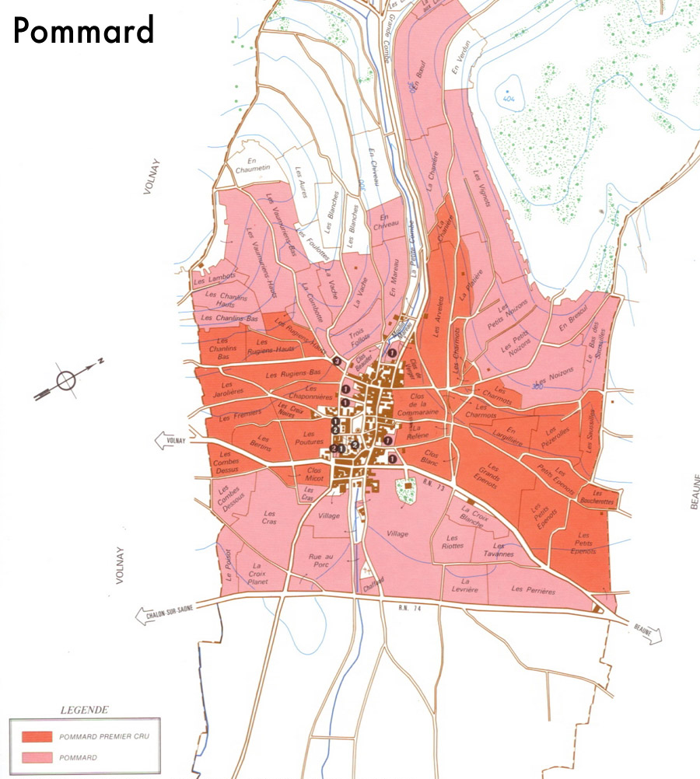

Slide 22
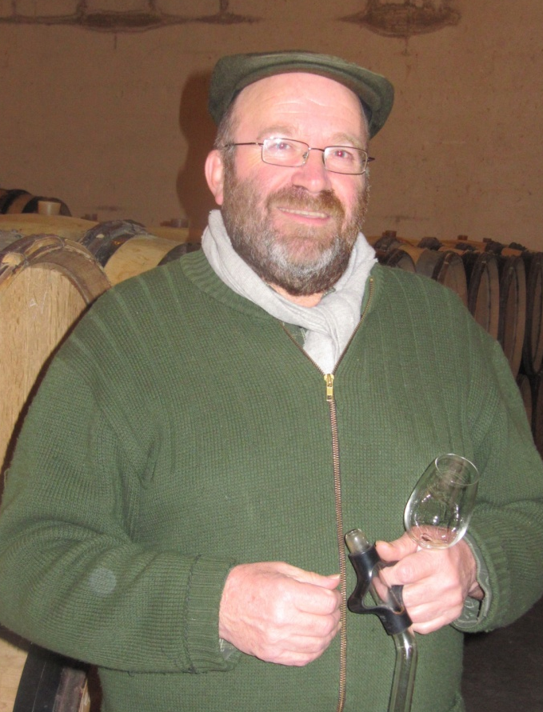
Boisson-Vadot
(Bernard, Pierre & Anne)
Meursault
A Sockless Hedonist & A Rising Star
The father-son team of Bernard and Pierre Boisson turns out between three and four thousand cases
of wine annually. While they are under-the-radar internationally, they are extremely well followed in
France.
In addition to the wines Pierre makes alongside Bernard, he makes a few wines on his
own with vineyard holding from his maternal grandmother’s side of the family. He is best pals with Raphael Coche of Coche-Dury, and the two spend hours together chatting about viticultural and winemaking philosophies.
The high percentage of old vines are carefully tended and the underlying terroirs are
allowed to take center stage due to the judicious use of new oak (only 25-30% for Crus
and less for village wines and Bourgogne Blanc).
Excellent, soil-driven, racy style that balances the natural richness of Meursault with
a laser-sharp focus.

Slide 23
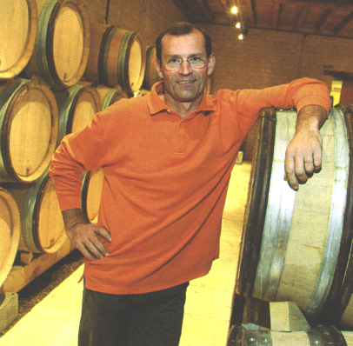
Jean-Philippe Fichet
Meursault
Precisionist
Fichet is testing the limits of transparency to find
The very soul of Meursault. Taking inspiration
from the late Rene Lafon who daringly bottled
Clos de la Barre on its own, Fichet vinifies and bottles
his stunning lieu-dits individually.
Fichet fastidiously oversees all aspects of viticulture and harvesting. The intense
stoniness of Meursault is magnified by a low water table that forcing roots to dig deep.
Jean-Philippe believes the expressiveness of his wines is enhanced thru a patient
18 month elevage with little new oak and the avoidance of lees stirring. His style is
reductive and closely resembles Roulot with riveting focus, delineation
and transparency.

Slide 24
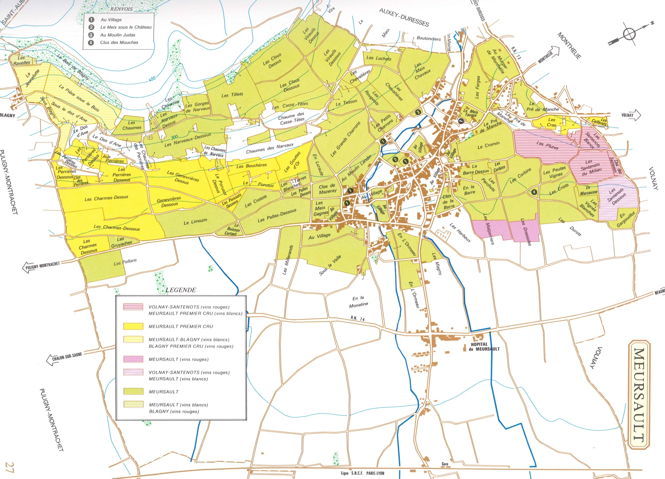

Slide 25
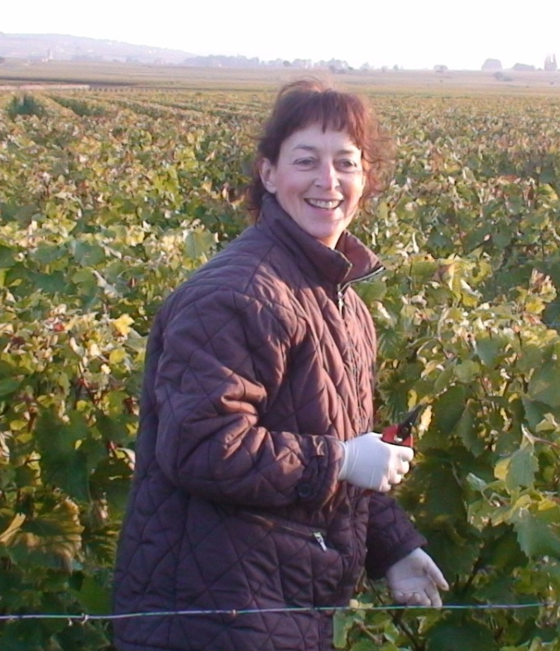
Paul Chapelle & Filles
Montagny-Les-Beaune
(Puligny & Santenay)
Treasure trove of vintages
Founded in 1976 when Paul Chapelle inherited a fine
parcel of vines in the 1er Cru of Gravières in Santenay.
He had made a name for himself as a consulting
oenologist at top estates in Burgundy including
Ramonet, Jobard, De Montille and La Pousse d’Or.
One of two daughters, Christine Chapelle fully holds the reins today. In addition to the Santenay Gravières, she crafts a lineup of white wines including Bourgogne Blanc, Meursault, Puligny villages, and Puligny 1er Crus Champgain and the old vine ridden Hameau de Blagny.
Despite its relative youth, the estate has an old-fashioned sensibility. They eschew
heavy doses of new oak and they are willing to age their wines in the cellar for a few
years prior to release…making them particularly restaurant-friendly! One of the
best kept secrets in Burgundy.

Slide 26
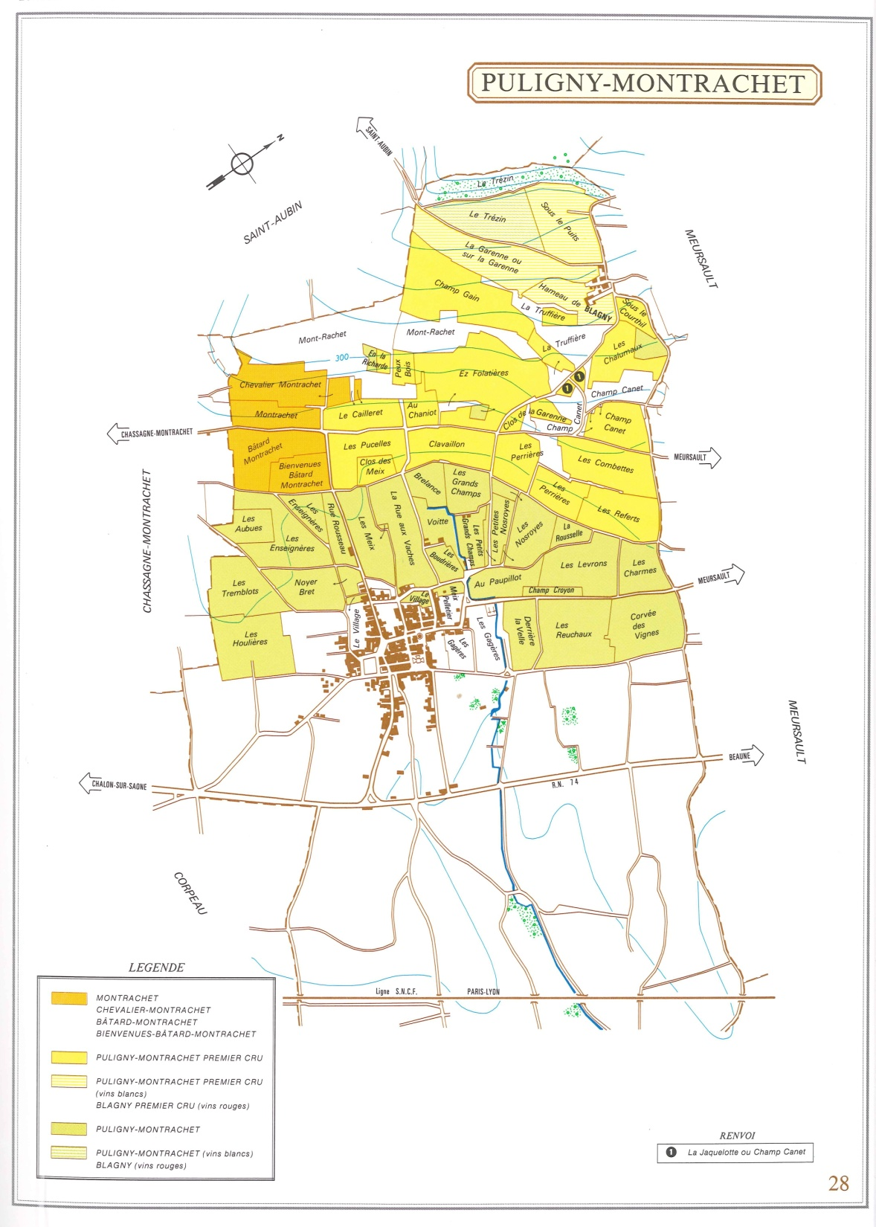
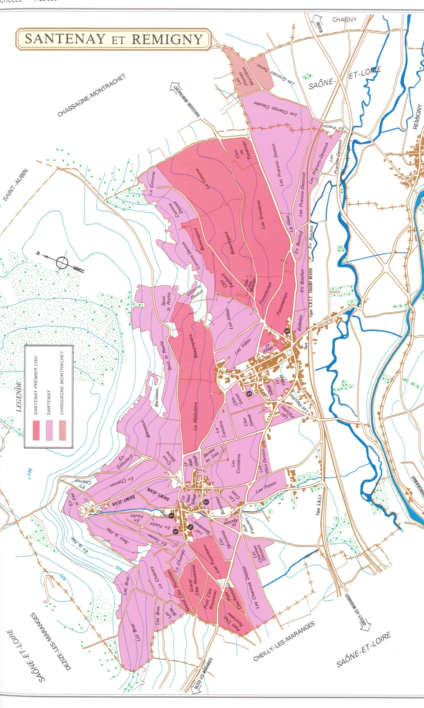

Slide 27
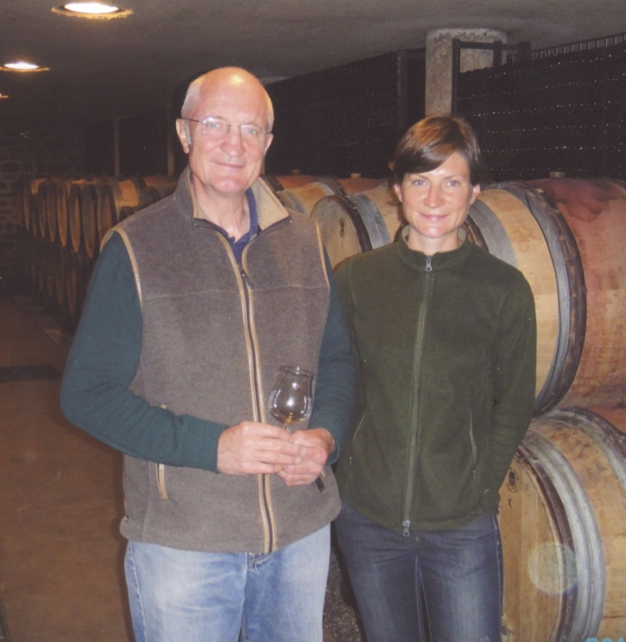
Fontaine-Gagnard
Chassagne-Montrachet
Epitome of Grace
One of the finest and most important growers
In the village of Chassagne-Montrachet. Richard
and daughter make lovely reds from Volnay
Clos de Chênes and Pommard Rugiens, but the
Heart and soul of the estate is their Chassagne
holdings, which include the famed Criots Batard, Batard and Le Montrachet.
Celine has firmly taken hold of the estate. She manages a team of seasoned
vineyard hands to tend to the vines throughout the year, ensuring impeccably clean,
optimally ripe fruit. She ages the wines in about 1/3 new oak for the 1er Crus and
a bit more for Grand Crus.
The Fontaine-Gagnard style is intense, racy, deep and complex Chassagne that
starts out classically balanced and accessible, but with the structure to age gracefully.
There is a luminosity to the wines – they are lifted and mouth-watering…liquid gold!

Slide 28
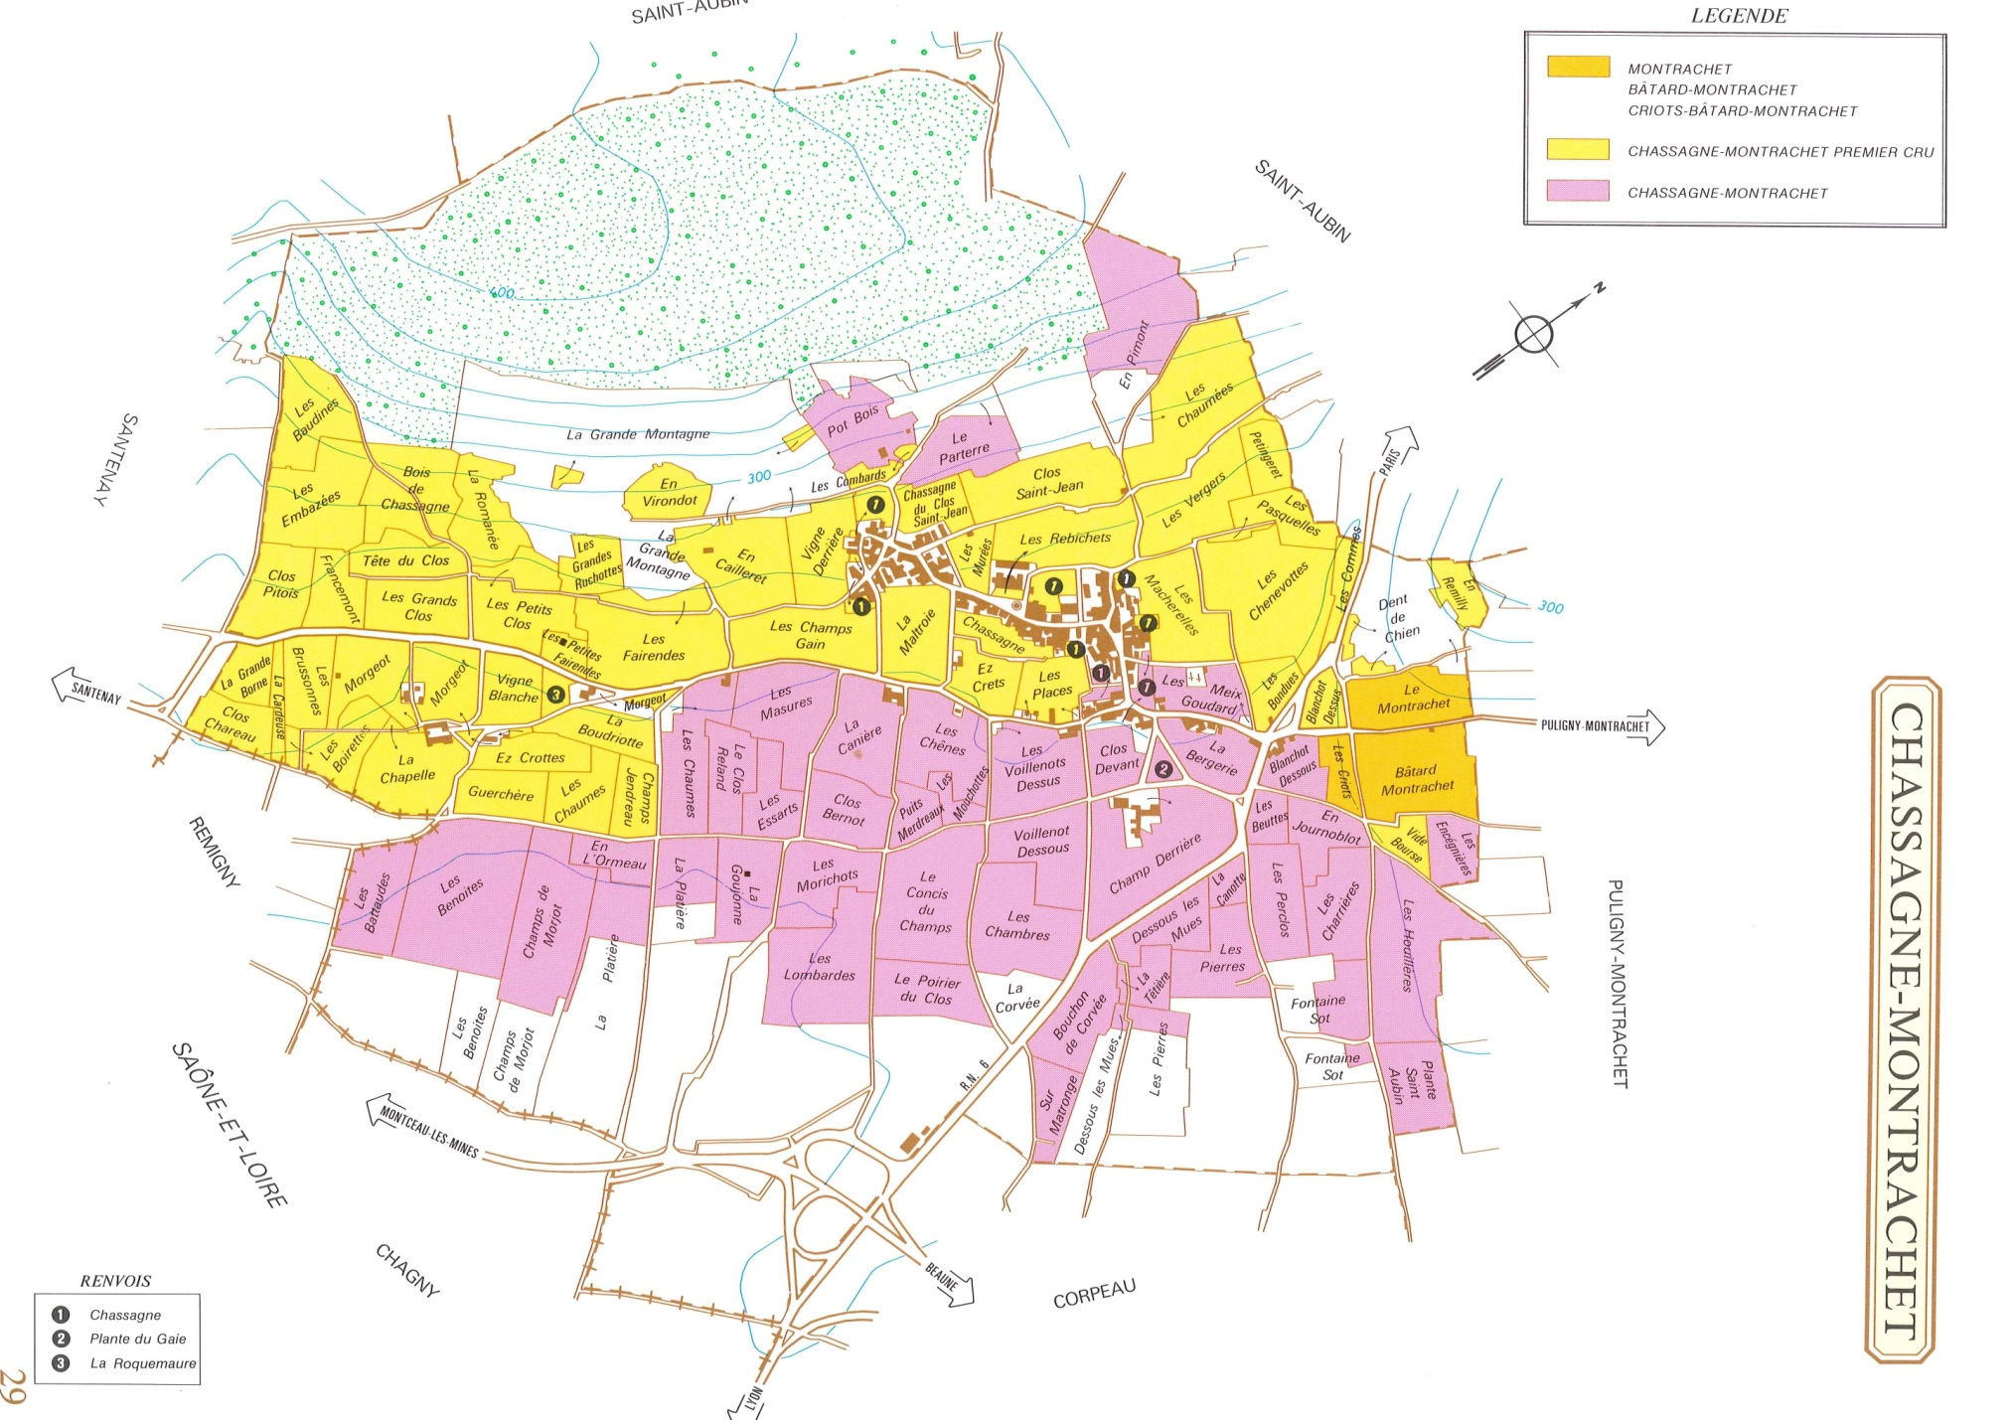

Slide 29
How to Sell Burgs in the Big Apple
Have no fear, use your tools
  Pull samples
  Study up
  Present with confidence
Education
  Explore – buy wine, taste wine, ask questions. Consider competition in new and old world.
  Identify talking points. What sets this grower/wine/terroir apart?
  Arm yourself with useful sales materials
Bottle-by-bottle
  Build a foundation and following
  Grass roots effort -- be a crusader!

