Slide 1
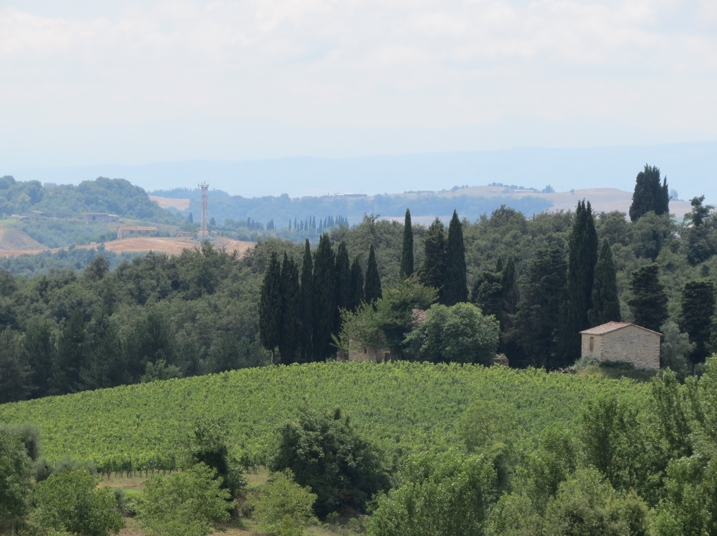
Chianti Portfolio
Polaner Selections
Chianti Classico
Casalino Vineyard (used for Fontalloro)

Slide 2
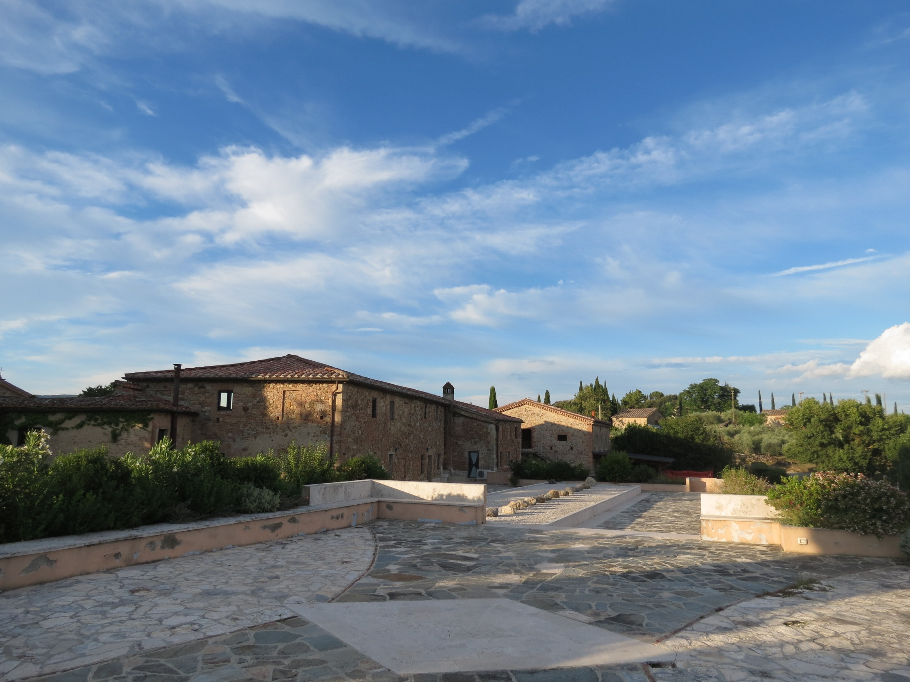
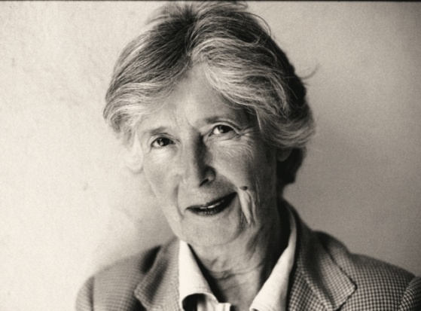
Castell’in Villa

Slide 3
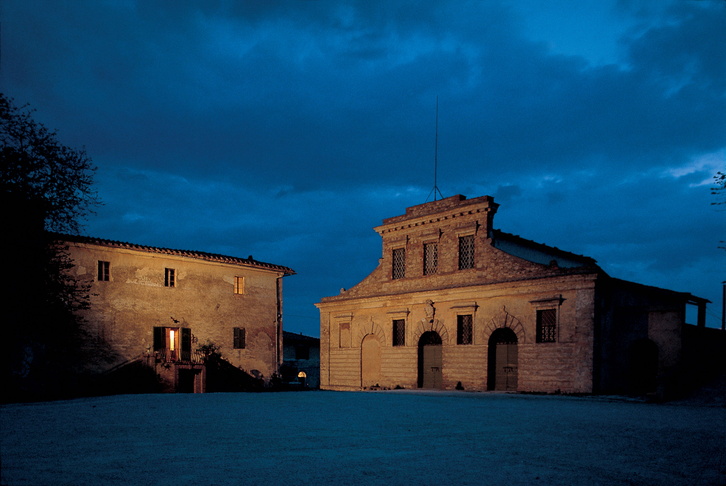
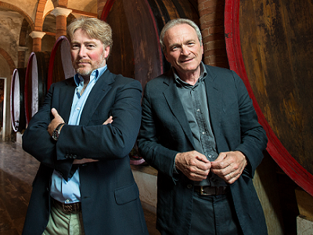
Felsina

Slide 4
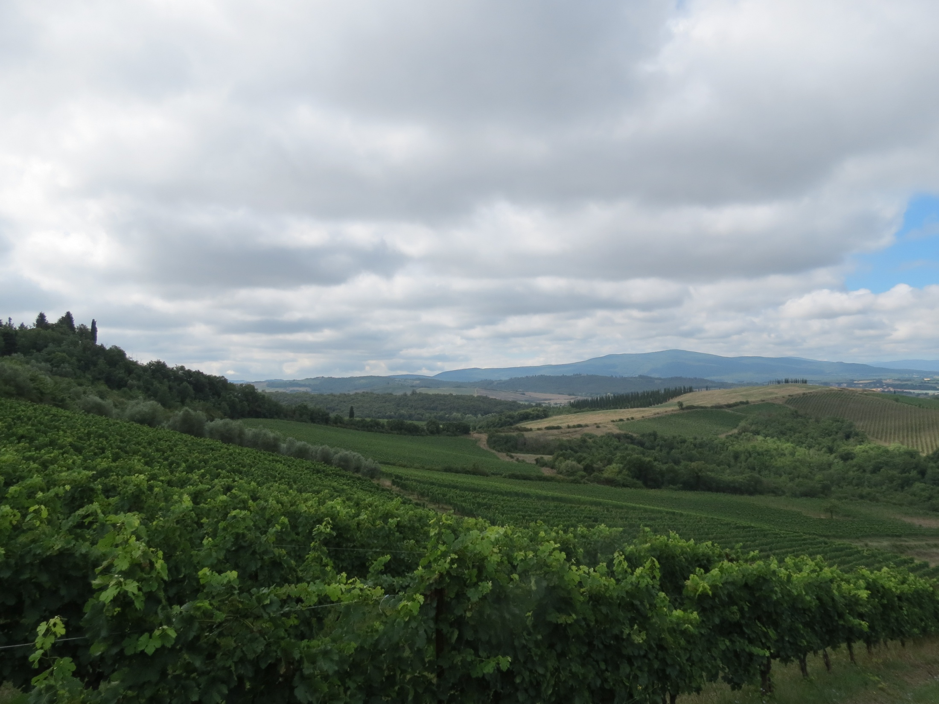
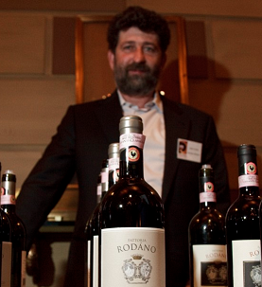
Rodano

Slide 5
Tuscany

Slide 6
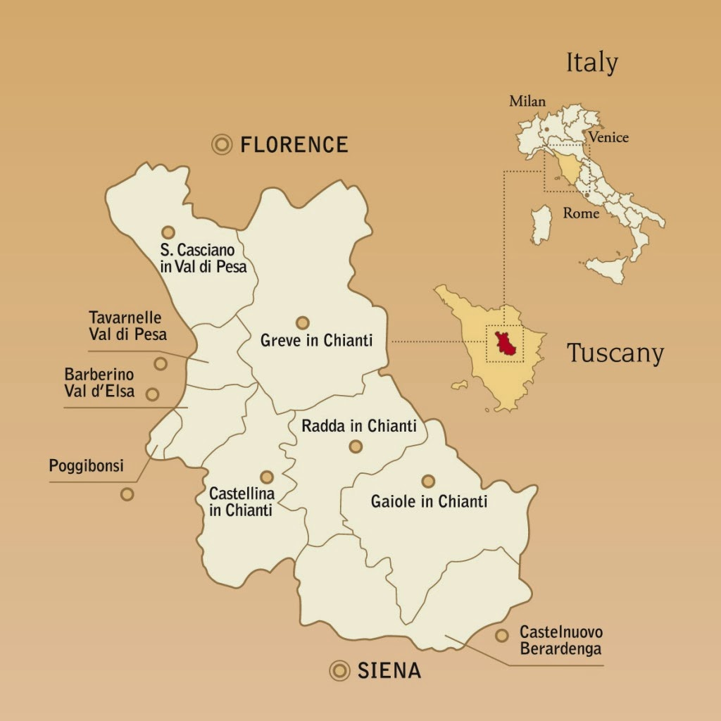
The Communes of Chianti Classico

Slide 7
Castellina in Chianti

Slide 8
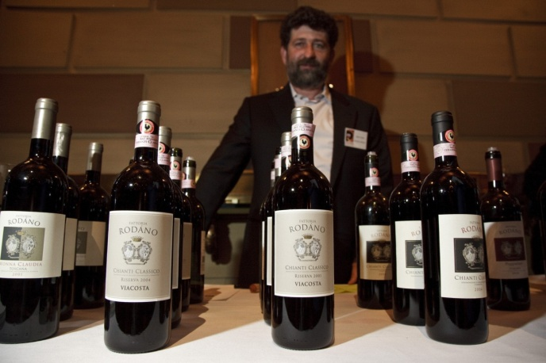
Fattoria Rodano History
Estate bought by Enrico’s grandfather Carlo in 1958
Carlo was a doctor in Castellina whose passion was wine and hunting, so he bought the estate
When Carlo died, his son Vittorio bought his sister’s half of the estate and planted 15 more hectares of CC.
First bottled vintage was 1967
For many years Giulio Gambelli was a consultant winemaker for them – he was well-known for consulting for Montevertine as well as Gianfranco Soldera.
Enrico began working in the winery in the 1980’s and began renovating the vineyards and planting additional ending up with 29 ha of CC and 5 of IGT.
In 1986 Vittorio quit his job as an engineer and focused on Rodano full-time. That year was also the first vintage of Viacosta.
2007 they were became certified organic though they had been practicing organic for years

Slide 9
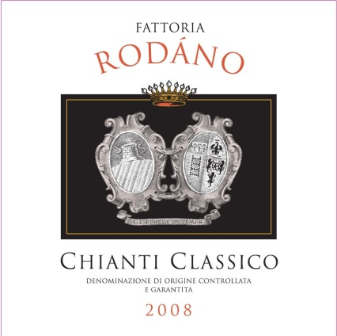
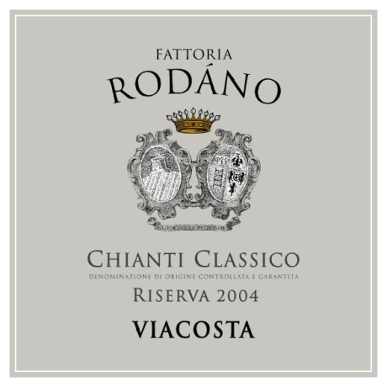
Fattoria Rodano
Chianti Classico- fermented in cement with ambient yeast. Spends about two years in large botti followed by some time in bottle before release.
Chianti Classico Riserva Viacosta – fermented in cement with ambient yeast. Spends about three years in large botti followed by time in cement and additional in the bottle before release.

Slide 10
Castell’in Villa & Felsina (satellite view)

Slide 11
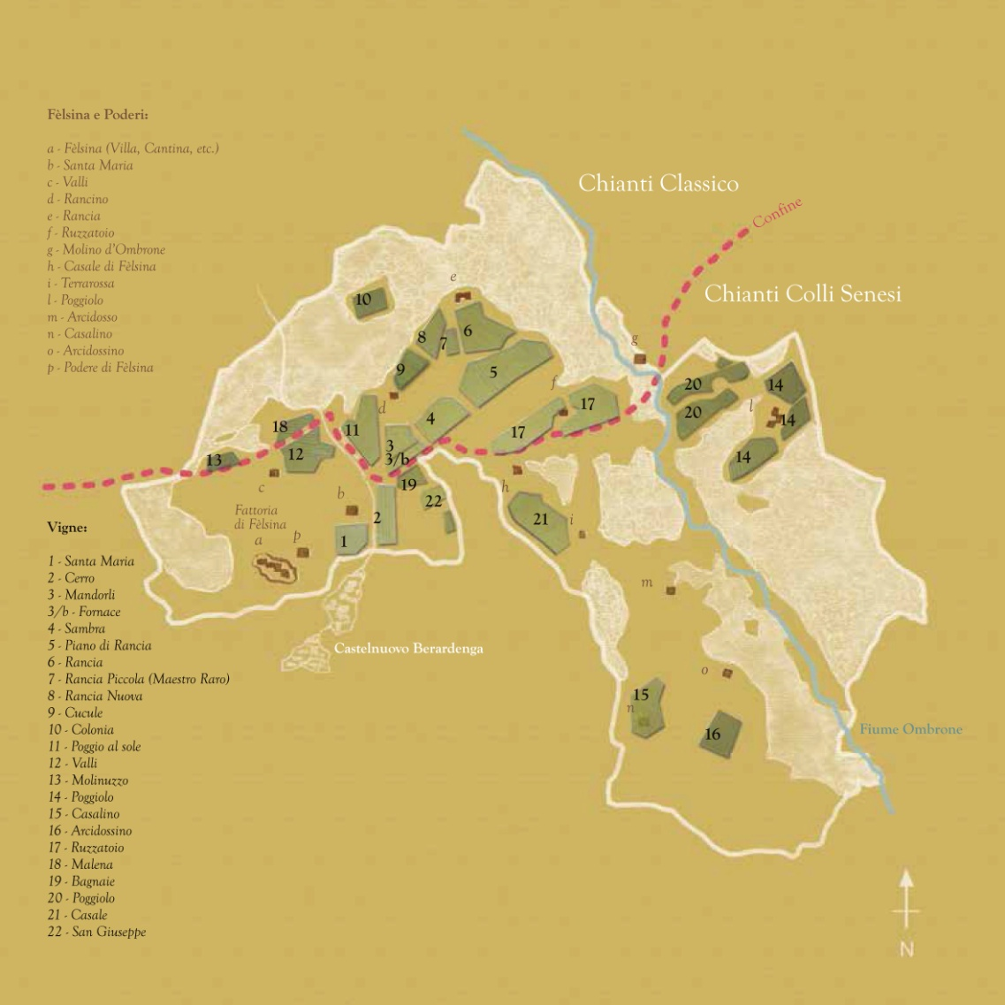
Vineyard Map for Felsina

Slide 12
Castelnuovo Berardenga

Slide 13
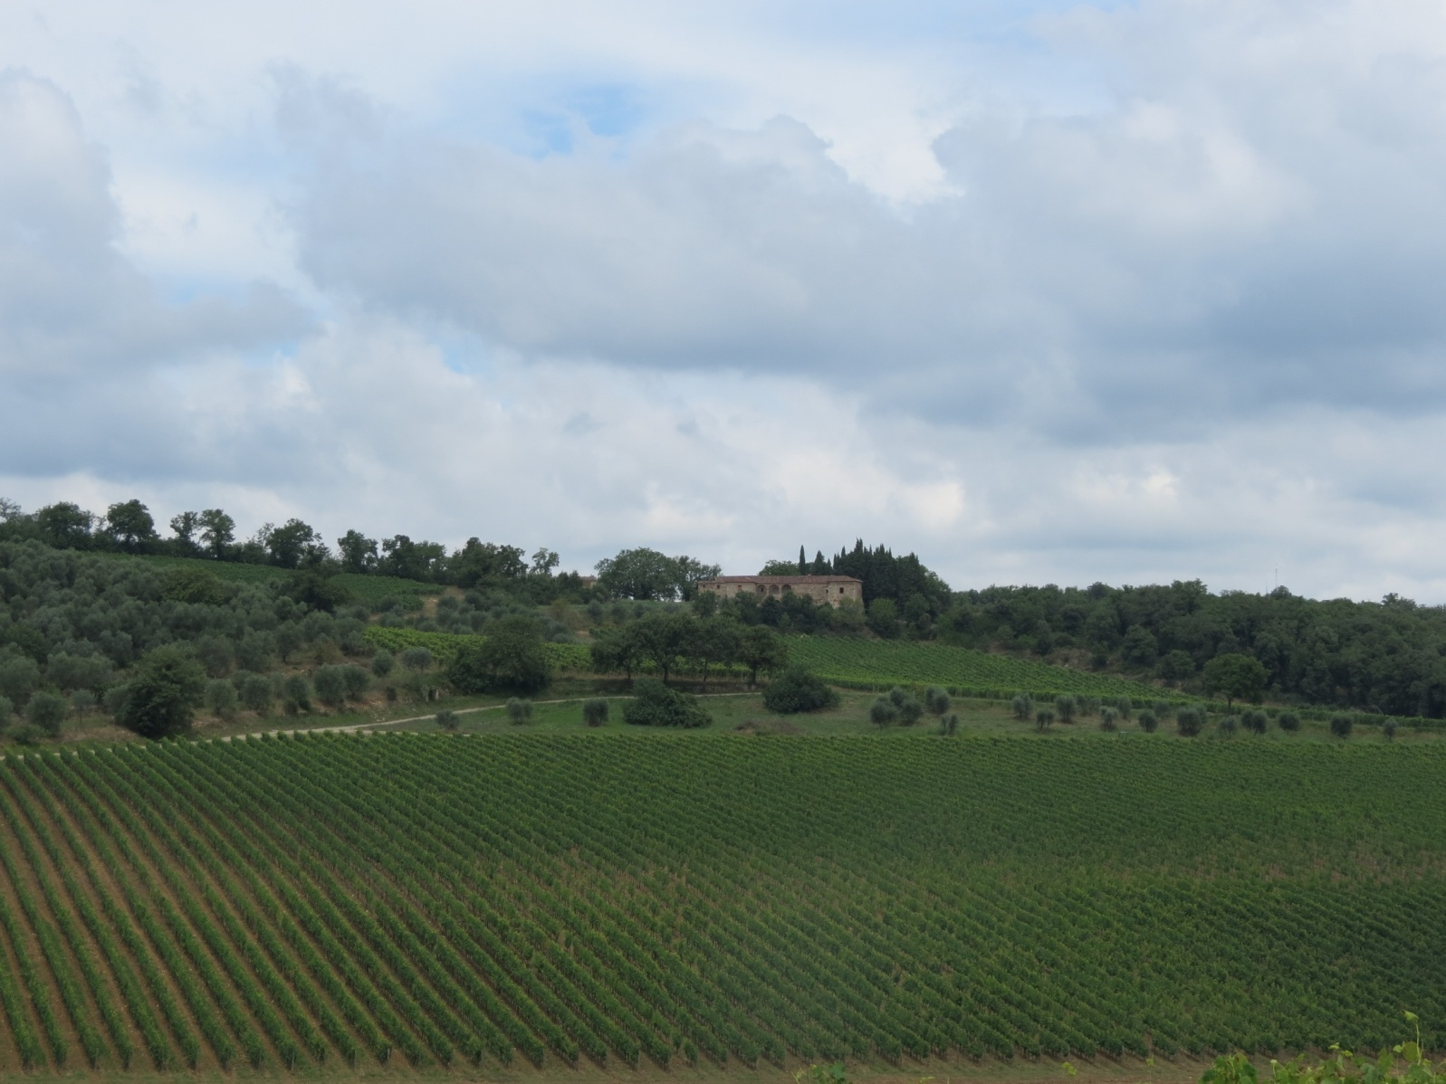
Felsina History
1966 Domenico Poggiali buys the estate
The Estate is made up of many medieval farmhouses – each with its own vineyard or vineyards. Many of the original owners of the farmhouses still work for the Poggiali’s tending the vineyards.
In the late 1970’s Giuseppe Mazzocolin takes over the commercial development of the winery
Franco Bernabei became involved as consultant winemaker in the early 1980’s – 1983 being the first vintages of Rancia and Fontalloro
Domenico Poggiali remained the titular head of the estate though Giuseppe Mazzocolin was running the day-to-day operations until very recently.
Giovanni Poggiali became involved in the winery in the 1990’s and has recently taken over the day-to-day operations with Giuseppe Mazzocolin in semi-retirement.

Slide 14
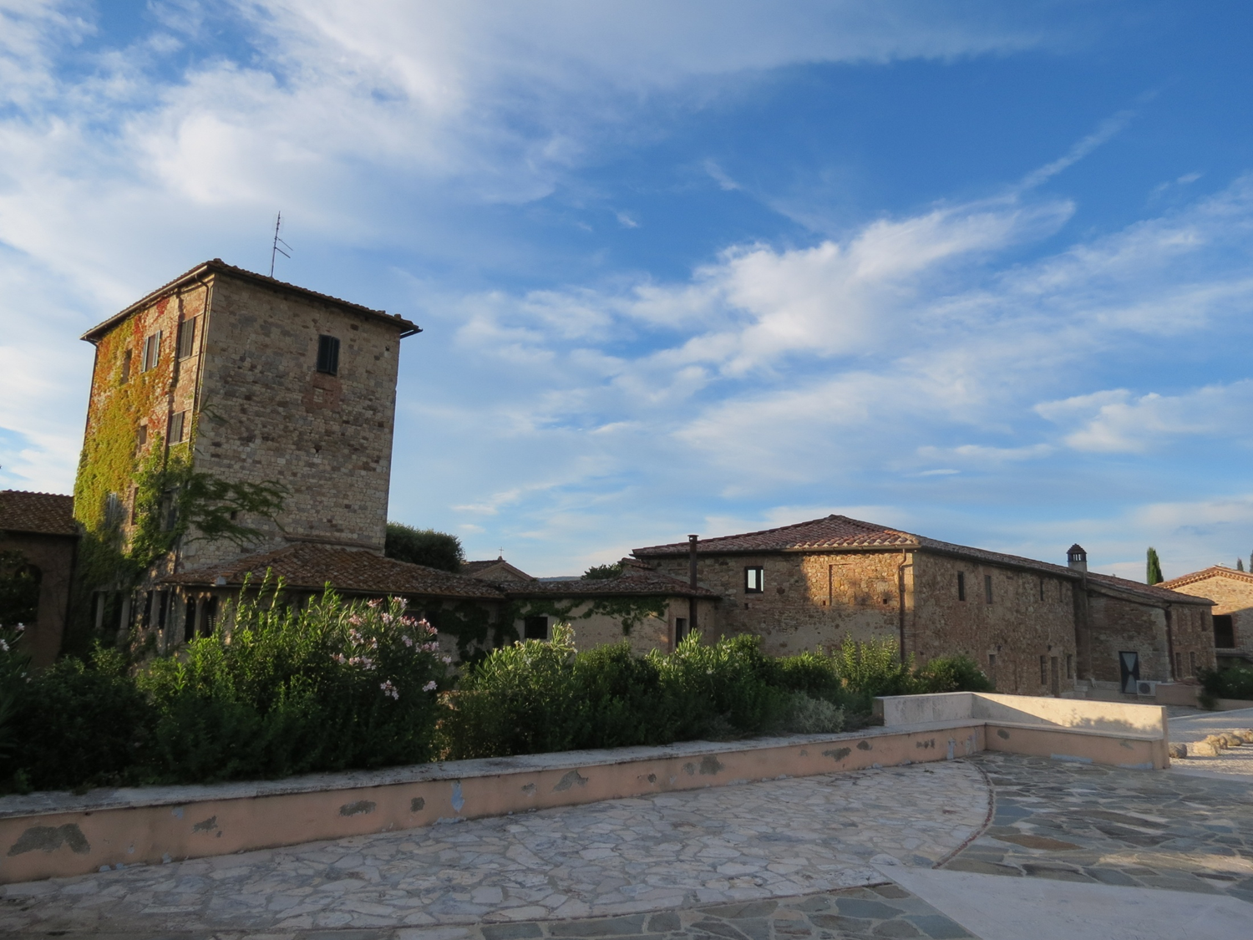
Castell’in villa History
1968 Coralia and her husband buy the estate where they planned to hunt and to make wine “for fun.”
1971 First vintage of CCR
1977 Coralia meets Giacomo Tachis, famed winemaker of Sassicaia and others, he does not act as official consultant but offers her advice including grafting Cabernet S. over her Canaiolo
1990 Poggio delle Rose vineyard planted
1996 1st commercial release of P. d. Rose

Slide 15
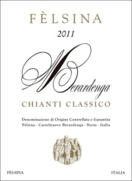
COMPARISON OF CASTELL’IN VILLA & FELSINA CHIANTI CLASSICO
Castell’in Villa Chianti Classico
100% Sangiovese
A mix of sandstone, limestone and alluvial soils.
Elevation 250-300 m
12-15 day fermentation in steel
Aged in large Slavonian oak for 24 months followed by a minimum of six months in the bottle.
Production 4,166 cases
Felsina Chianti Classico
100% Sangiovese
Alluvial soil with pebbles and sand.
Elevation 320-420 m
10-12 day fermentation in steel
Aged in large Slavonian oak for 12 months followed by a minimum of three months in the bottle.
Production 20,000 cases
They use both selected and indigenous yeast

Slide 16
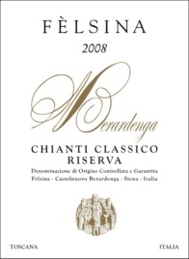
COMPARISON OF CASTELL’IN VILLA & FELSINA
CHIANTI CLASSICO RISERVAS
Castell’in Villa CCR
100% Sangiovese
Alluvial soil with pebbles and a mixture of limestone, clay and sand.
Elevation 300 m
12-14 day fermentation in steel
Aged in large Slavonian oak for 24-36 months followed by six to 12 months in the bottle.
Production 1,250 cases
Felsina CCR
100% Sangiovese
A mix of sandstone, limestone and alluvial soils.
Elevation 320-420 m
14-16 day fermentation in steel
Aged in large Slavonian oak for 12 to 16 months followed by three to six months in the bottle.
Production 5,000 cases

Slide 17
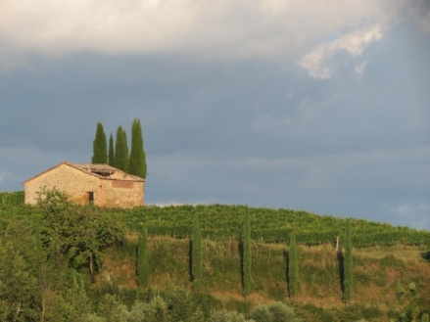
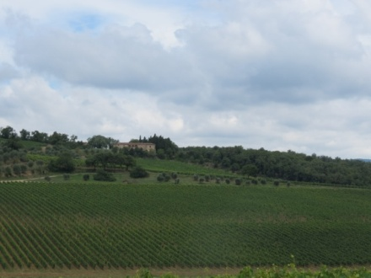
COMPARISON OF POGGIO DELLE ROSE AND RANCIA
Castell’in Villa CCR Poggio delle Rose
100% Sangiovese
Alluvial soil with pebbles and a mixture of limestone, clay and sand.
Elevation 350 m
12-14 day fermentation in steel
Aged first in new and used barriques followed by large Slavonian oak for a total of 24-36 months then at least 12 months in the bottle.
Production 833 cases of six
Felsina CCR Rancia
100% Sangiovese
A mix of sandstone, limestone and alluvial soils.
Elevation 400-420 m
14-16 day fermentation in steel
Aged first in new and used barriques for a total of 18-20 months then at least six months in the bottle.
Production 5,000 cases of 12

Slide 18
Wine tasting
Rodano Chianti Classico 2009
Rodano Chianti Classico Riserva Viacosta 2007
Felsina Chianti Classico 2011
Castell’in Villa Chianti Classico 2010
Felsina Chianti Classico Riserva 2010
Castell’in Villa Chianti Classico Riserva 2008
Castell’in Villa Chianti Classico Riserva 2006
Castell’in Villa Chianti Classico Riserva Poggio delle Rose 2008
Felsina Chianti Classico Riserva Rancia 2008
Castell’in Villa Santacroce 2007

Slide 19
Chianti Classico map of some key competitors

