Slide 1
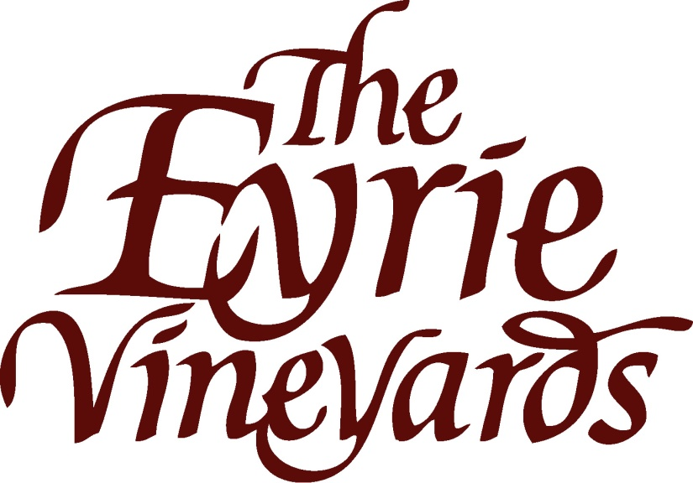
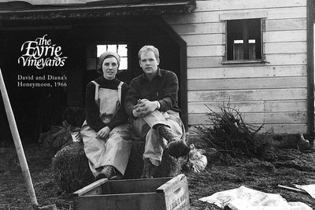
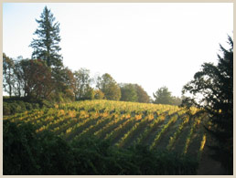
Polaner Selections June 29, 2012
Willamette Valley
History
The vineyards
Winemaking & Wines

Slide 2
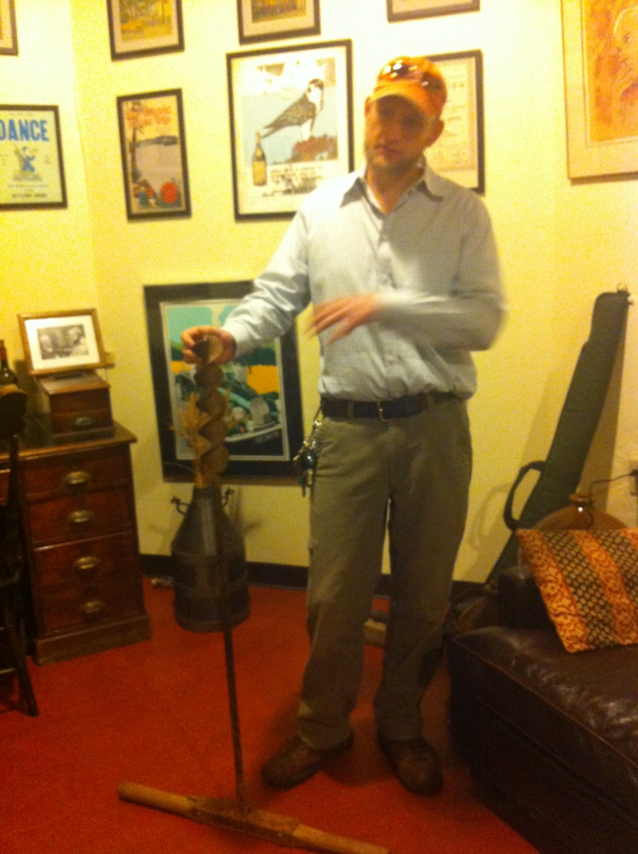
Willamette Valley
Climate:
Relatively mild with cool, wet winters and warm, dry summers
Most of the rainfall occurs in the winter, not during growing season
This temperate climate, combined with coastal marine influences, make the gentle growing conditions within the Valley
The VanDuzer corridor is the primary moderating influence
A gap in the coastal range that allows marine influence into the valley
This wind gap tempers the entire valley but is especially evident in the vineyards of Eola Amity
Soils:
Volcanic soil-the primary volcanic soils is Jory-basalt-based and found in most vineyard sites in the Dundee Hills. Jory is high in clay content and iron, reddish in color and nutrient-rich. These soils are a result of the Missoula Floods
Sedimentary soil-The mustard-tinted Willakenzie is the best-known sedimentary soil
Loess, or windblown silty loam-the shallowest of our three main soil types-somewhere in between sticky volcanic and dusty sedimentary

Slide 3
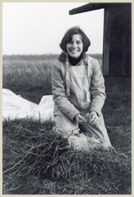
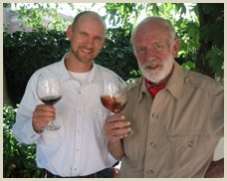
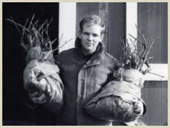
The History of eyrie: the start of an industry
In 1965 David & Diana Lett moved to Oregon with 3000 cuttings and a theory
David earned a degree in viticulture from UC Davis and worked as a text book salesman while searching for a vineyard site
The cuttings are planted in a nursery in Corvalis, Oregon
1966 - cuttings planted at the original Eyire Vineyard in what will become the Dundee Hills
1970-The first vintage of Eyrie is released
1975, The Eyrie Vineyards produced the first American Pinot noir to compete successfully with the renowned Pinot noirs of Burgundy. (Paris, 1979; Beaune, 1980).

Slide 4
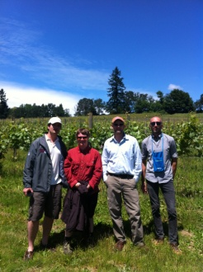
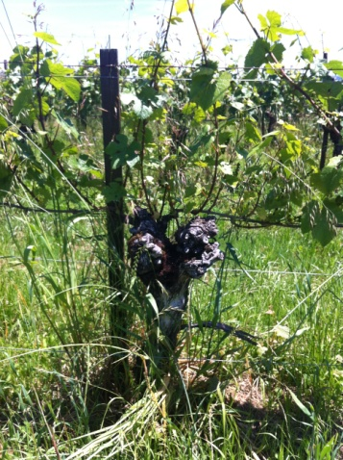
The Vineyards
The Eyrie Vineyard-
The original planting of vines in the Dundee Hills planted in 1966
220’-400’ elevation
20 acres of Pinot noir, Chardonnay, Pinot gris, Pinot Meunier, Muscat Ottonel
This vineyard is the source of the “single vineyard” Estate Reserve Pinot noir, and special bottlings of South Block Reserve
Stonehedge & “Daphne” Vineyard-
Planted in 1979 and 80 just up hill from the original Eyrie Vineyard.
720’-820’ elevation at the top of the Dundee Hill,
13 acres of Pinot Gris, Pinot Noir, Pinot Meunier.
More rocky, Jory soils
Rolling Green Farm-
540’-820’ elevation between Eyrie and Stonehedge
6 acres planted to Pinot Noir and Pinot Gris
Three Sisters Vineayrd-
200’-360’ elevation
16 acres planted to the three lovely Pinot Sisters-Pinot Noir, Pinot Gris and Pinot Blanc

Slide 5
Winemaking
The winemaking style is based on picking at maturity without being overripe and taking care in the winemaking not to compromise those flavors. This means minimal racking, extended lees contact, complete and spontaneous malolactic fermentation, no fining, minimal filtration, etc.
“Estate” Wines"-mostly from the three “younger” vineyards: Stonehedge, Sisters, and Rolling Green Farm, planted in the 1980’s.
Pinot noir: Aged 11 months in mostly neutral oak casks, the wine is not fined, and is filtered only if necessary.
Pinot gris: Fermented in stainless steel tanks, slow elevage on the lees until bottling.
Chardonnay: Aged on the lees for eleven months in neutral oak, and given one loose filtration before bottling, the wines are subtly expressive, elegant, and long-lived.
Single-Vineyard “Original Vines Reserve” Wines-All grapes come from Eyrie’s original plantings
Pinot noir Reserve: Fermented in small bins using native yeasts for primary and secondary fermentation. Up to 24 months in French oak-bottled without filtration or fining.
Chardonnay Reserve: A barrel selection these wines are aged for nine months or more on unstirred lees, in a combination of neutral and new French and Oregon oak casks. It receives only one gentle filtration prior to bottling.

Slide 6
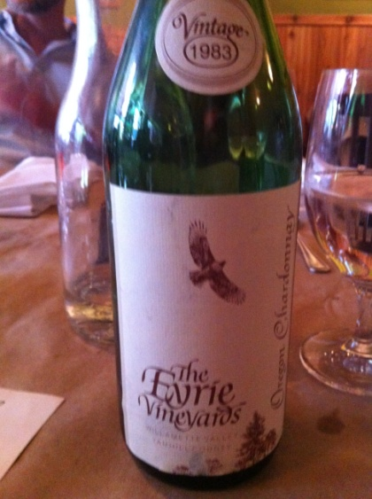
The Wines
Eyrie Vineyards Pinot Gris 2010 (12/750) $144, 136/5, 132/15
Eyrie Vineyards Pinot Noir 2009 (12/750) - $308, 296/5
Eyrie Vineyards Pinot Noir Reserve 2009 (12/750) - $520
Eyrie Vineyards Pinot Noir Daphne Vyd 2009 (12/750) - $649

