Slide 1

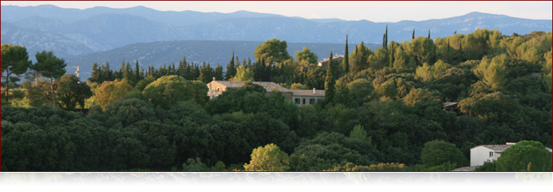
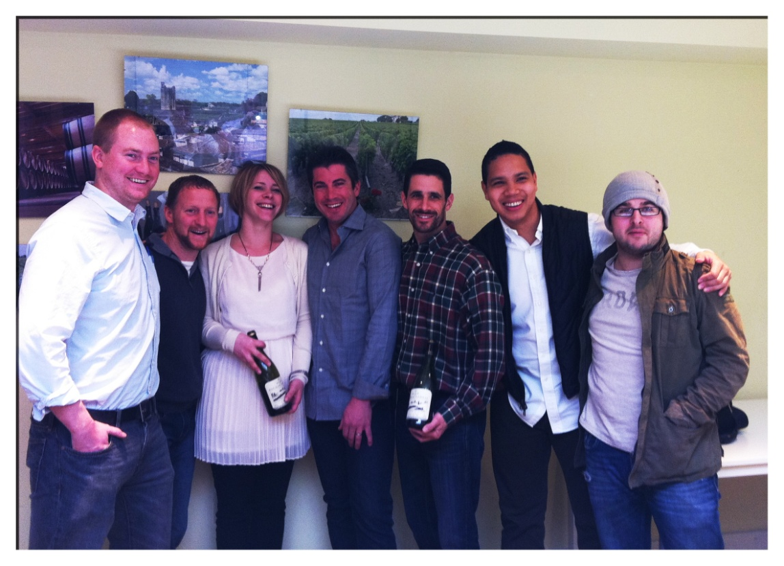
History
Terroir
Microclimate
The Wines

Slide 2
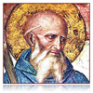
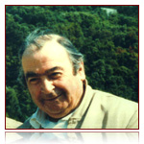
history
The first wines ever produced in the Gassac Valley are said to date back to 780 AD when St Benoit d’Aniane, one of Charlemagne’s counselors, planted the first vineyard
Aimé Guibert purchased the vineyards in 1974 and began planting grapes. The first official vintage of the Grand Vin was 1978, with the help of the great Bordeaux enologist, Emile Peynaud
First estate in the Languedoc to adopt full organic farming and can honestly say that the estate has never seen any chemicals. Their commitment to preserving and protecting the land is unparalleled. After all, it’s where they eat, drink and live!

Slide 3
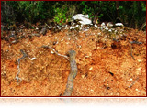
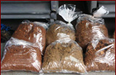
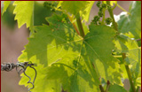
Terroir
A rare and still unexplained red, powder-fine glacial soil was discovered in the 1970s by the great academic, Henry Enjalbert, then the Chair of Geography at the University of Bordeaux
Enjalbert compared the land to the best Burgundy terroirs in the Côte d’Or. Formed from deposits carried in by the winds during the Riss, Mindel and Guntz glacial periods (ranging from 180,000 – 400,000 years ago), the terroir provides the three elements necessary for crafting Grand Cru wines:
Deep soil ensuring the vines’ roots delve deep to seek nutrients
Perfectly drained soil ensuring roots are unaffected by humidity
Poor soil meaning that vines have to struggle to survive, an effort which creates fine aromas

Slide 4
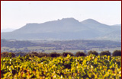
Microclimate
It’s challenging for a great terroir to give of its best in a very hot climate. The Gassac Valley is blessed with a cool microclimate equivalent to a climatic altitude of some 500 meters (1650 ft)
At nightfall, the cold air from the Larzac floods into valley resulting in cool nights, even in the height of the summer
The northern facing vineyards are exposed to less direct sunshine during the hot summers and the vines flower some three weeks later than the Languedoc average
This cool microclimate is largely responsible for the outstanding complexity and finesse of Daumas Gassac wines

Slide 5
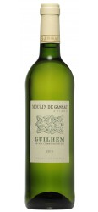
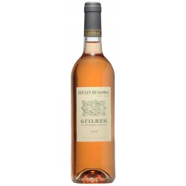
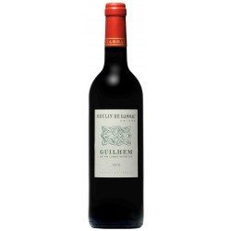
The Guilhem wines
Moulin de Gassac Guilhem Blanc 2011
$104, 96/5, 84/15, 76/25
40% Grenache Blanc, 30% Sauvignon Blanc, 30% Clairette
100% destemmed, all varieties co-fermented for 2-3 hours in temp
controlled tanks
Aged 5-6 months in stainless steel
Powerful, fruity aromatics. Bright, lively acidity
Moulin de Gassac Guilhem Rosé 2011
$104, 96/5, 84/15, 76/25
40% Grenache, 40% Carignan, 20% Syrah
100% destemmed, bled after 10-12 hours of maceration.
Aged 5-6 months in stainless steel
Pleasant nose with hints of strawberries. Full and round with red fruit aromas
Moulin de Gassac Guilhem Rouge 2010
$104, 96/5, 84/15
40% Syrah, 25% Grenache, 20% Mourvèdre, 15% Carignan
100% destemmed, all varieties co-fermented. 10-12 day maceration, no filtration
Aged 6-7 months in stainless steel
Complex aromas with hints of red berries and spice. Delicate and sophisticated on the palate, with soft tannins

Slide 6
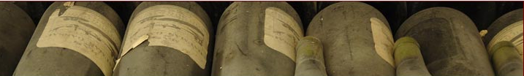
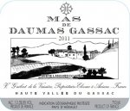
The grand crus
Mas de Daumas Gassac Blanc 2011
$396
33% Chenin Blanc, 33% Viognier, 33% Petit Manseng
5-7 day maceration. Fermentation and 6-7 months aging in stainless steel
Complex stonefruit aromas. Rich and full on the palate with notes of honey and apricot and a mineral core
Mas de Daumas Gassac Rouge 2010
$396
80% Cabernet Sauvignon, 20% Cabernet Franc, Pinot Noir, Merlot, Tannat
Long fermentation and maceration (at least 20 days) in tank. No filtration. 13-16 months in barrel (10% new wood max)
Reminiscent of great Médoc when young, but takes on more Burgundian characteristics with age

Slide 7
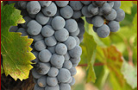
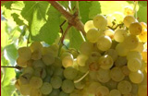
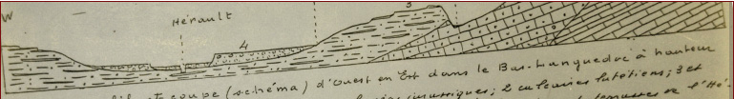
Major selling points
Multi-generation family estate
Unique soils
Very cool microclimate
More than forty different and often rare grape varieties
Organic viticulture since the beginning
Extraordinary ability to age

