Slide 1
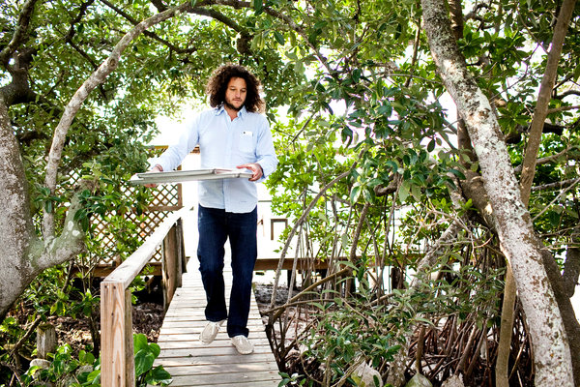
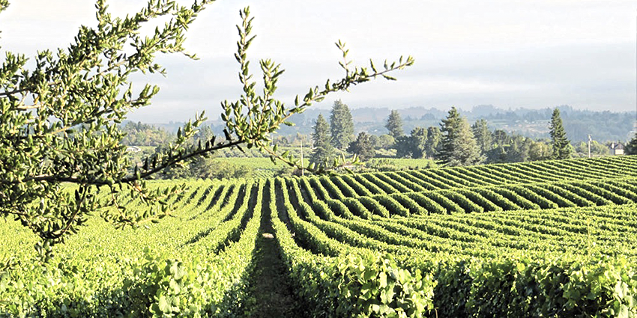
LOLA Wines
Unpretentious, everyday wines with balance

Slide 2
Philosophy
LOLA Wines was founded by Seth Cripe who worked for the Wagner family at Caymus
LOLA was started because Seth felt that California wines could be balanced and made to go with food while still remaining affordable for everyday
The grapes are picked less ripe for lower alcohol
Minimal intrusion in the winemaking process using native yeasts and minimal racking
Limited use of new oak
Freshness is emphasized

Slide 3
Sapere Aude Sparkling NV
Made in the Charmat or tank method.
A blend of Napa Valley Chardonnay, Riesling and Orange Muscat
Sapere Aude is a Latin term meaning "dare to know".
184, 176/5, 168/15

Slide 4
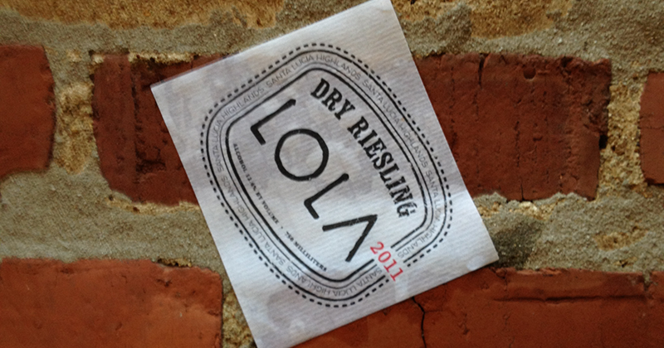
Dry Riesling Santa Lucia Highlands 2012
Franconi Vineyard
Cement fermentation, 20% on skins
6 months in stainless steel
700 cases produced
152, 144/5, 136/15 cases

Slide 5
Chardonnay Sonoma Coast 2012
The vineyards for the Chardonnay are in Occidental and Bloomfield
Goldridge loam soils-the classic soil of the Sonoma Coast and RRV
Fermented in cement with 20% malolactic
20% 2nd year year French oak, 80% Stainless Steel tank
1400 cases produced
184, 176/5, 168/15

Slide 6
Pinot Noir North Coast 2011
A selection of vineyards from Mendocino, Sonoma Coast and Russian River Valley
Goldridge loam, Clay loam
20% whole cluster, open top fermentation, hand punch downs
French oak-40% 2-4 year old barrels, 60% older-for 6 months
2200 cases produced
184, 176/5, 168/15

Slide 7
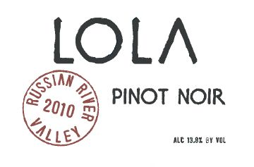
Pinot Noir RRV 2012
A selection of vineyards from the Russian River Valley
Goldridge loam soils
20% whole cluster, open top fermentation, hand punch downs
100% French oak, 40% new for 6 months
900 cases produced
240, 220/5

Slide 8
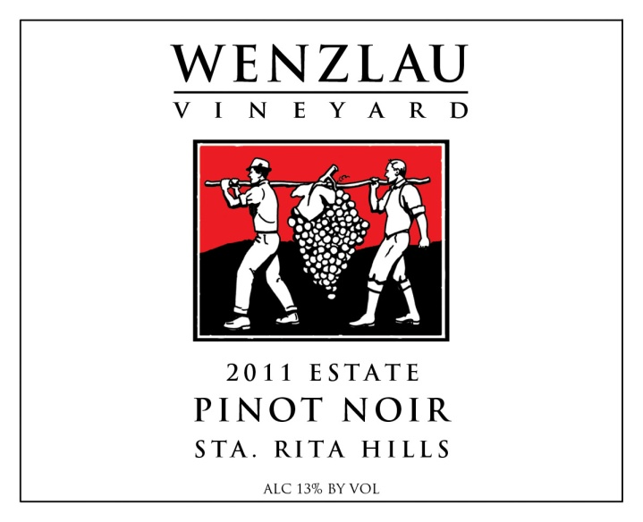
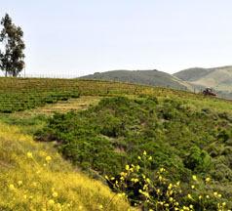
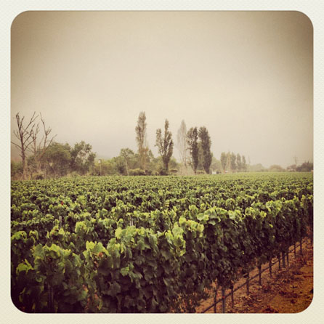
Wenzlau Vineyard
A new discovery in the Santa Rita Hills

Slide 9
Santa Rita Hills AVA
Sta. Rita Hills is part of the larger Santa Ynez Valley AVA
Located between the towns of Lompoc and Buellton with the Purisima Hills on the north and the Santa Rosa Hills on the South.
The hills run east to west, which allows cool ocean breezes from the nearby Pacific Ocean to enter the valley created by the hills and create a cool micro-climate.
The wine region is exposed to fog and coastal breezes from the nearby Pacific Ocean.
When combined with the rocky nature of the area, the Santa Rita Hills area is well-suited for the growing of Pinot noir grapes
The AVA is best known for Chardonnay, Pinot noir, and Syrah

Slide 10
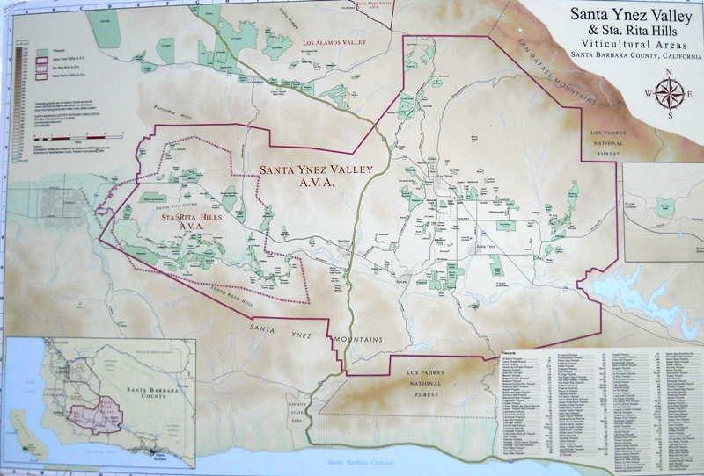

Slide 11
The Vineyard-
The Wenzlau Vineyard is a family owned site located on the western end of the Sta. Rita Hills appellation, northwest of Santa Barbara, California.
It sits on a 100-acre parcel that runs from the Santa Ynez River up through the hills & canyons of the Santa Rita Hills.
The vineyard is just 12 ½ planted acres (5 ½ Chardonnay, 7 Pinot Noir)
This provides the vineyard with ample untouched space for constant air circulation and natural biodiversity that the Wenzlau family believes is extremely beneficial for growing the best quality fruit.
The vines are rooted in clay and limestone soils, and are planted on south facing hillsides. A cooling ocean fog creates a unique microclimate.
The vineyard is tended with organic viticulture which allows a natural and honest expression of the terroir.
The wines are made by winemaker Justin Willett who also makes wines under the Tyler label.
The production is about 500 cases total. In the future there will also a very small production Cremant or sparkling wine made with the assistance of famed Champagne winemaker Cedric Bouchard.

Slide 12
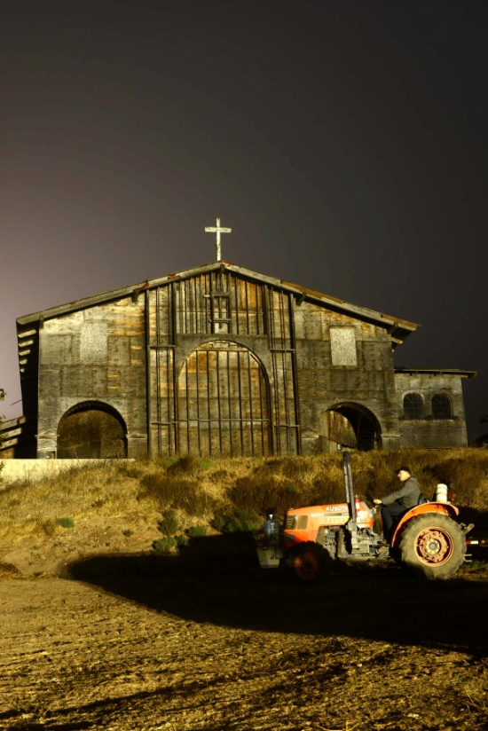
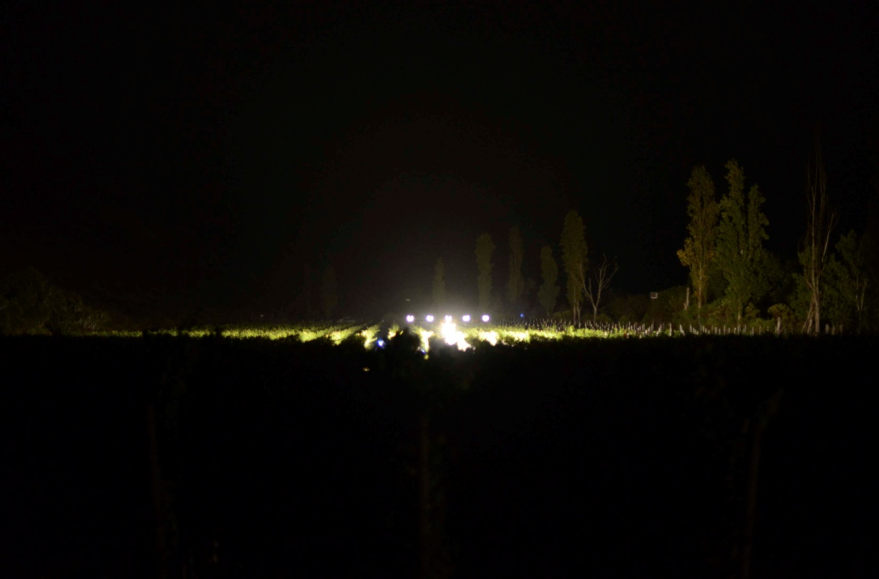
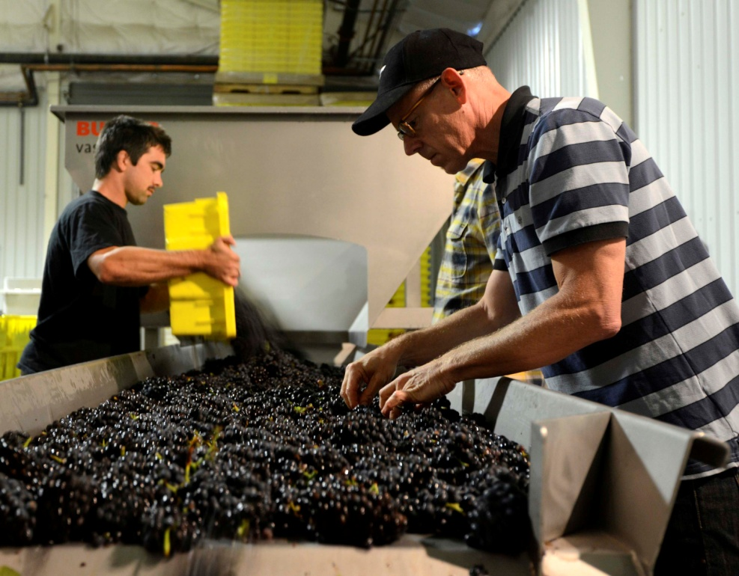
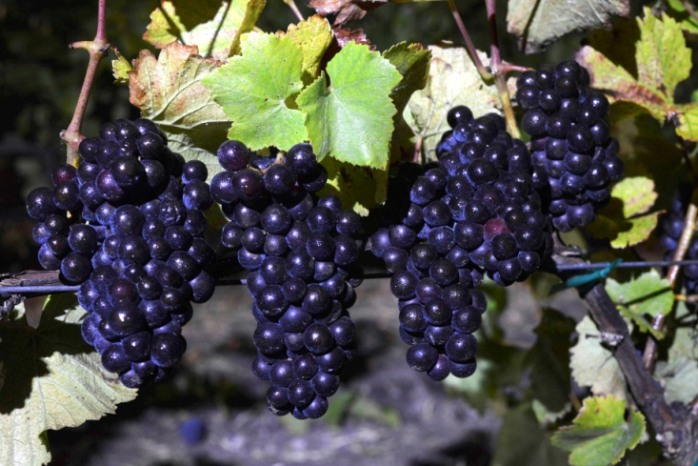

Slide 13
Wenzlau Chardonnay Estate 2011
Pressed to tank, settled over night, racked off heavy lees to another tank for fermentation
Once active it was transferred to about 25% new wood and the rest to older French oak barrels
No stirring during primary or secondary fermentation
Full malolactic
Left on the lees just under a year and racked to tank to rest for four months before bottling
233 cases produced
440/case

Slide 14
Wenzlau Pinot Noir Estate 2011
Predominately destemmed in 2011 with one block retaining 40% of the stems-about 20% of the overall wine
30% new French oak-predominantly Sirugue and Damy.
Once in barrel the wines are left on the lees for a little over a year
They are then racked and blended in tank and put back down to barrel for a few more months
Bottled at about 18 months-unfined and unfiltered
293 cases produced
480/case

Slide 15
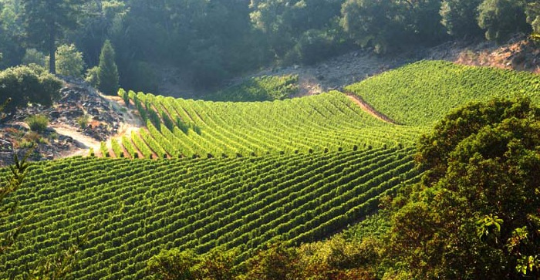
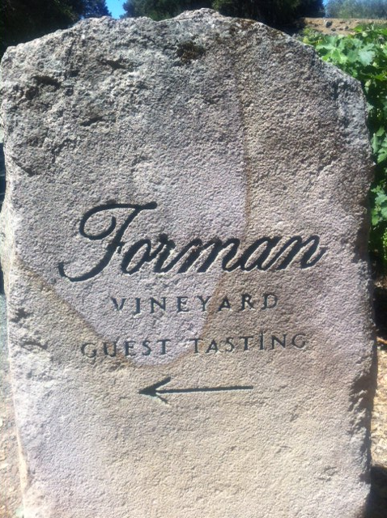
Forman Vineyard
Classic Napa Valley wines of elegance and finesse

Slide 16
History of Forman
Ric Forman received a BS and then MS at UC Davis in enology and viticulture
He helped with harvest at Stony Hill in 1967 and Robert Mondavi in 1968.
In 1969 Ric was hired to help design, build and run Sterling Vineyards and in 1970 he took his first trip to Bordeaux which has influenced all of his work since
In 1975 Sterling was sold and Peter Newton started Newton with Ric in 1978
After a long search of the Napa Valley, Forman was purchased by Ric Forman in 1979
The first vintage of Forman was 1983

Slide 17
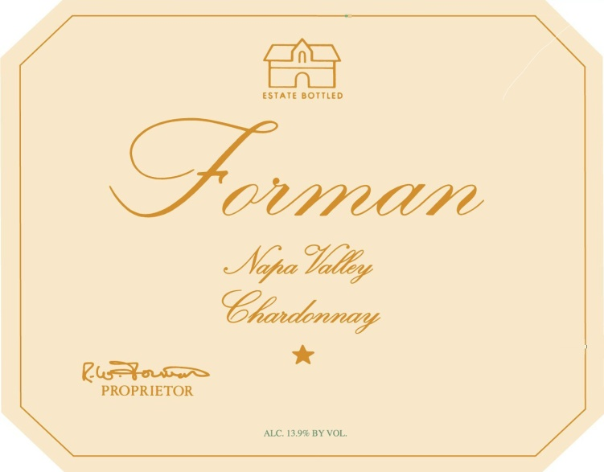
Forman Chardonnay Napa Valley
Rutherford Star Vineyard-Rutherford Bench
Hand harvested grapes
Slowly whole cluster pressed
Barrel fermented in Burgundy barrels 10% of which are new
Left sur-lees for 7 months the wine is only racked once during its 9 months of barrel aging.
Malolactic fermentation intentionally inhibited
420, 400/5

Slide 18
Rossi-Wallace Pinot Noir Napa 2012
100% Atlas Peak Vineyard (Antinori Vineyard)
Hand harvested grapes
Fermented in small batches from ¾ of a ton to 4 ton lots
After fermentation the newly pressed wine goes into Burgundy barrels that are 50% new, 50% 1 year
The lees are stirred and the wine is never racked
687 cases produced
276, 256/5

Slide 19
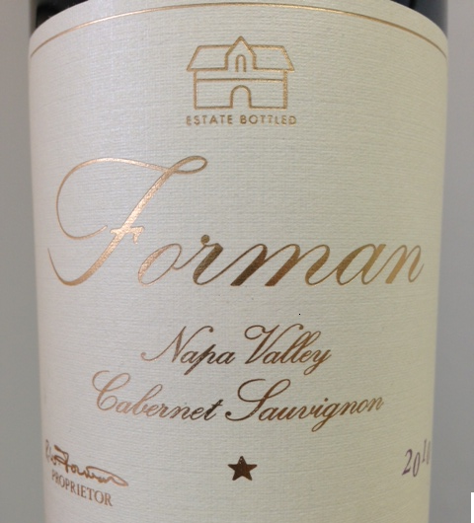
Forman Cabernet Napa Valley
100% Estate grown - St. Helena Appellation-all hillside vineyards surrounding the winery at the base of Howell Mountain.
Hand Harvested
A blend of 75% Cabernet Sauvignon, 15% Cabernet Franc, 5% Merlot, 5% Petit Verdot
Vinified in small 4-5 ton fermenters. 3-4 week fermentation/maceration
100% French Bordeaux barrles. 50-65% new for 20 months.
ML done in barrel + fining in barrel with egg whites.
780/case

