Slide 1
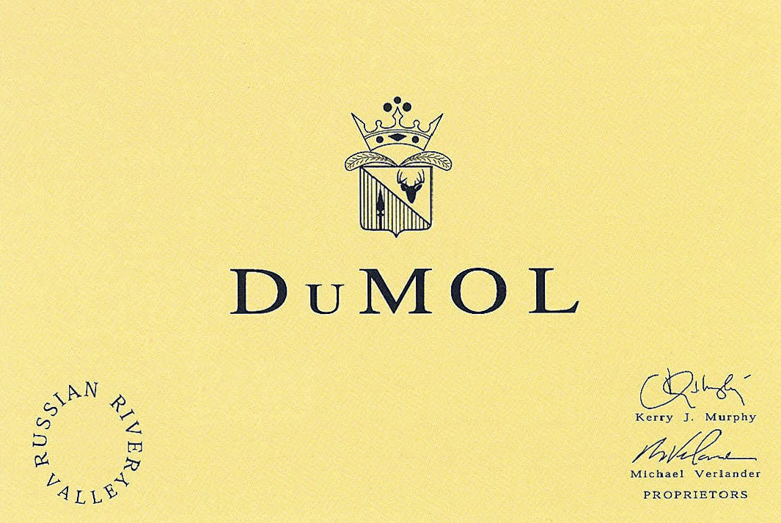
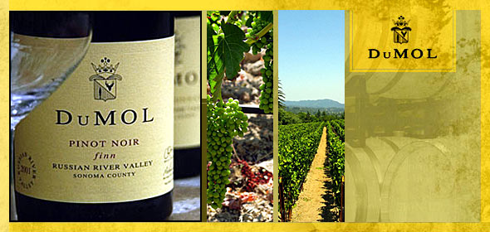
The Wines of DuMOL
2010 Designate & Russian River wines

Slide 2
History of DuMOL
DuMOL was founded in 1996 by Kerry Murphy and Michael Verlander
The first winemaker was Paul Hobbs and the winery is named after his children-Duncan and Molly
Andy Smith took over as winemaker in 2000 and became a partner in DuMOL in 2005
The Estate Vineyards were purchased in 2003 and 2004 and total 25 acres
The winery was built in 2008. Prior to that the wines were made at Copain Custom Crush

Slide 3
Russian River vs. Designate wines
Russian River wines
Designate wines
Blends of vineyard sites that come together in the DuMOL style
The RRV wines are released in the spring
Single vineyard wines or blend of 2 sites
Named after family and friends of the principals
The Designate wines are released in the fall

Slide 4
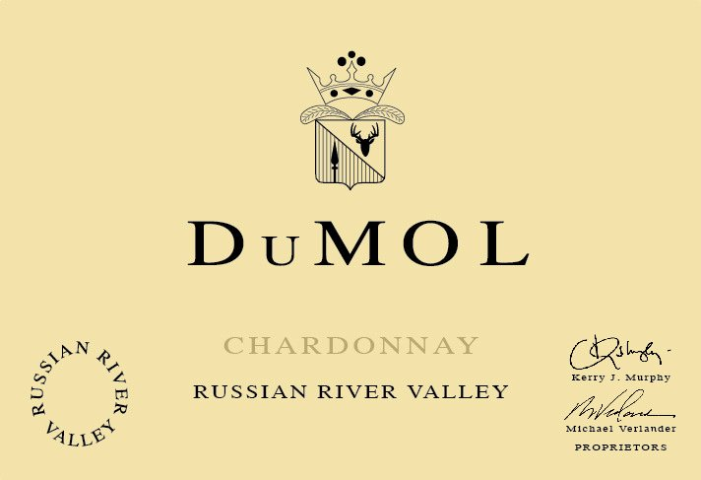
Chardonnay RRV 2010
A 6 vineyard blend-
50% Dutton Ranch, 25% Heintz, 10% DuMOL Estate, 6% Hyde, 6% Lorenzo, 3% Joy Road
Hand harvested grapes sorted in the vineyard
Slowly whole cluster pressed
Barrel fermented with native yeast
Complete malolactic fermentation
15 months aging in 40% new French oak.

Slide 5
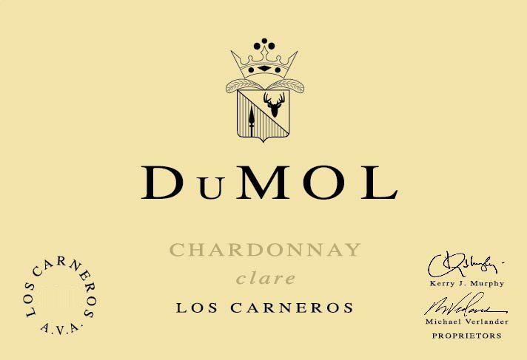
Chardonnay Clare Carneros 2010
100% Hyde Vineyard-Carneros
Hand harvested grapes
Barrel fermented with native yeast
Partial malolactic fermentation
Aged for 15 months in 50% new French oak
No filtration

Slide 6
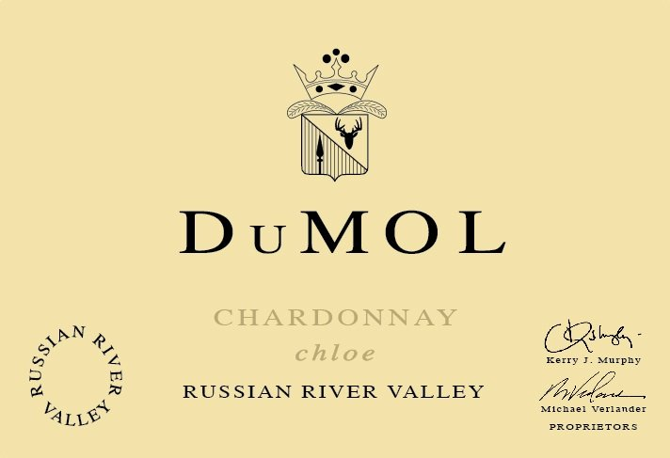
Chardonnay Chloe RRV 2010
100% Ritchie Vineyard
Wente Selection-38 year old vines
Hand Harvested
Barrel fermented with native yeast
Complete malolactic
15 months in new French oak
No fining or filtration

Slide 7
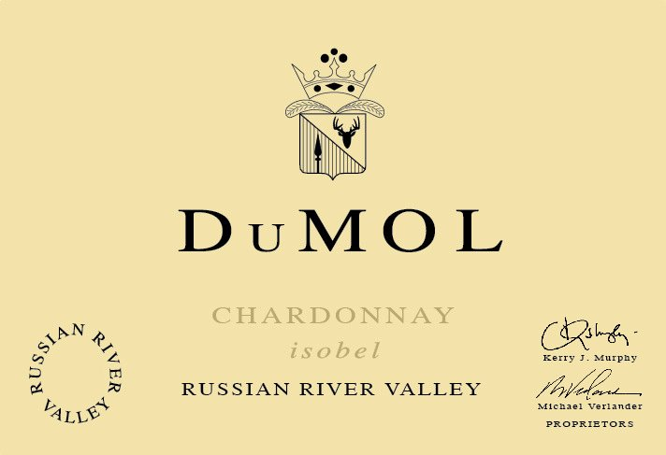
Chardonnay Isobel RRV 2010
100% Charles Heintz Vineyard
29 year old vines
Hand harvested
Complete malolactic
Aged 15 months in 40% new French oak
No filtration at bottling

Slide 8
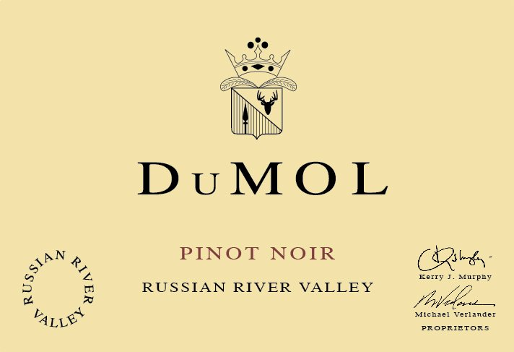
Pinot Noir RRV 2010
8 vineyard blend - 34% Dutton Ranch, 16% Gunsalus, 12% DuMOL Estate, 10% Abbott, 8% Hansel, 8% Joy Rd, 6% Greywacke, and 6% Sonoma Stage.
Vine Age: 4 to 25 years
Hand harvested grapes, sorted in the vineyard and winery
Native yeast and malolactic fermentations
Aged 11 months in 35% new French oak barrels followed by 3 months settling in tank
Bottled unfiltered

Slide 9
Pinot Noir Ryan RRV 2010
100% Widdoes Vineyard-Russian River Valley
Martini Selection
28 year old vines
Hand harvested grapes, sorted in the vineyard and winery
Native yeast and malolactic fermentations
Aged 14 months in French oak barrels, 45% new
No filtration at bottling.

Slide 10
Pinot Noir Aidan RRV 2010
100% Wildrose Vineyard-Russian River Valley
11 year old vines
Dijon clones 115 and 777
Hand harvested grapes, sorted in the vineyard and winery
Native yeast and malolactic fermentations
Aged 14 months in French oak barrels, 40% new
No filtration at bottling
455 cases produced

Slide 11
Pinot Noir Estate RRV 2010
100% DuMOL Estate vineyard.
Planted with 3x4 foot spacing
This results in 3630 plants/acre as opposed to 1100
Clones: Calera, Swan, Pommard, 667 and 777.
Vine Age: 6 years.
Hand harvested grapes, sorted in the vineyard and winery
Native yeast and malolactic fermentations
Aged 14 months in French oak barrels, 55% new
No filtration at bottling.

