Slide 1
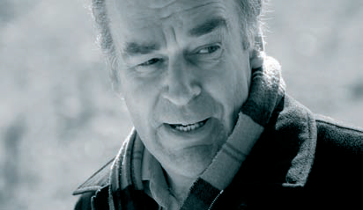
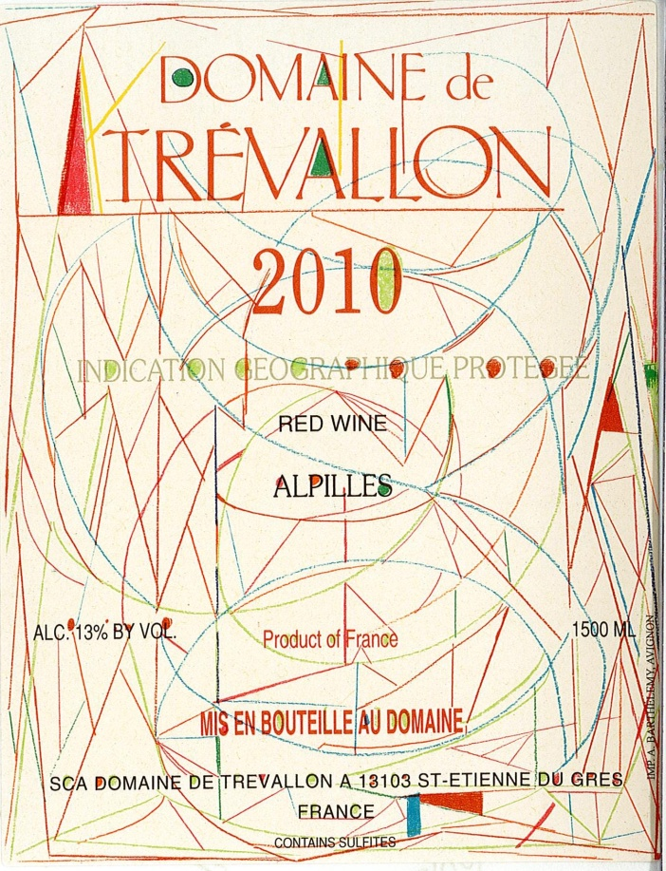
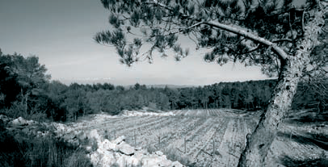
POLANER SELECTIONS APRIL 5, 2013
DOMAINE DE TRÉVALLON

Slide 2
HISTORY
Eloi Dürrbach began planting vines in the three valleys (where the estate gets its name) in 1973. he and his father René had studied the old texts of the famous 19th-century viticulturalist, Doctor Guyot, who claimed that much of the Bouches-du-Rhône had been planted to Cabernet Sauvignon before the arrival of phylloxera.
divided their red grape holdings equally among Cabernet Sauvignon and Syrah, Both of which thrive in the deep chalky soils, and the 50/50 blend turned out to be the perfect balance between the wild qualities of the Mediterranean basin and the structure of a more northerly climate.
Farm organically and plow to encourage the roots of the vines to plunge deeper into the soil for water and nutrients. They believe in pruning short, which not only reduces the yields but extends the life of the plant by 20 to 50 years.
forced into accepting the lesser Vin de Pays du Bouches-du-Rhône and IGP status due to INAO regulations stating that no more than 20% cabernet is allowed in the vineyard. As it turned out, their rebellion reflected just as much avant-gardist thinking as it did a purist’s respect of tradition.

Slide 3
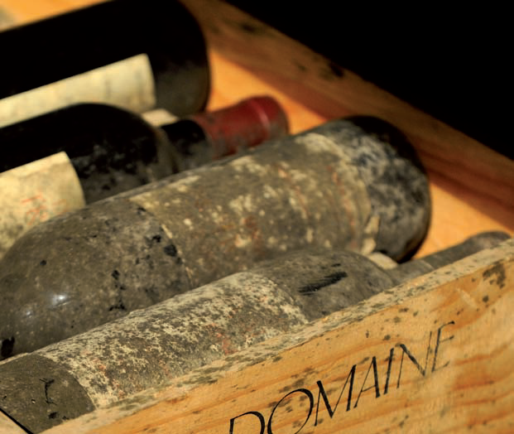
IGP Alpilles Rouge
Domaine de Trévallon IGP Alpilles Rouge 2010 $460 $460
Domaine de Trévallon IGP Alpilles Rouge 2008 $440
Domaine de Trévallon IGP Alpilles Rouge 2003 $480
vines grown in the Trevallon at the base of the
rocky walls of the Alpilles mountains.
very rocky, Limestone-rich vineyards facing north toward
the alpilles range.
Whole cluster, wild yeast fermentation. The wine undergoes regular punch-downs and pump-over's of the cap before extended aging. 24 month elevage in combination of foudres and barrel.
This unique and rebellious blend of 50% Syrah and 50% Cabernet Sauvignon displays transporting aromas of the provencal garrigue and has velvety textures and tannins that promise a long life.

Slide 4
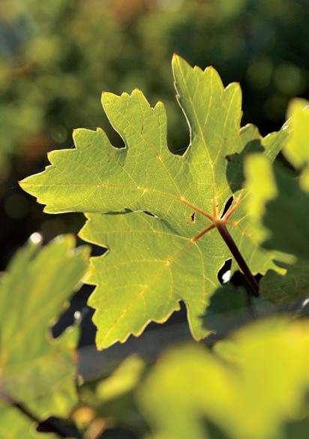
VdP Bouches-du-Rhone Blanc 2011 $640
Marsannay, Roussanne and Chardonnay vines grown in the trevallon at the base of the rocky walls of the Alpilles mountains.
very rocky, Limestone-rich vineyards facing north toward the alpilles range.
Whole cluster, wild yeast fermentation.
Very limited due to low yields of 20 hectolitres/hectare.
The fact that the vines are grown on north-facing slopes gives incredible freshness and imparts a minerality and elegance to the Marsanne grape comparable with that found in a Hermitage white. The Roussanne is typically acidic and develops aromas of verbena, citronnella and honeysuckle. Eloi likens the addition of Chardonnay to “adding salt and pepper to a dish”.

Slide 5
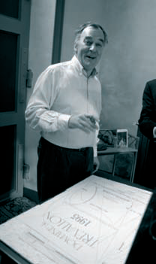
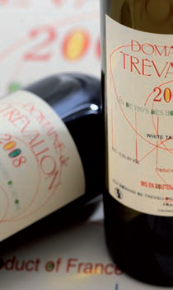
On the very special labels
The now iconic Trévallon labels first appeared in the 1996 vintage.
They were designed by René Dürrbach, Eloi’s father, who died in 1999 at age 89. He was an artist and sculptor who counted Fernand Leger, Robert Delaunay and Pablo Picasso amongst his friends.
Eloi presented him with 50 labels and he started drawing on them according to his inspiration. Each year the family chooses a label which they feel corresponds to the characteristics of the vintage.

